Slide 1

Introduction to Microsoft Endpoint Manager
Module 2

Slide 2
Module Overview
In this Module, we'll go through the following topics:
Paths to modern management
Microsoft Endpoint Manager and Intune
Exploring Windows 10 Enterprise in detail
Bring your own device (BYOD)
What is zero trust?
Notes:
Chapter Overview
The basics of modern management are sometimes complicated to understand. You will learn about the concept of modern management and zero trust with Intune as part of Microsoft Endpoint Manager, along with its history and architectural concepts, to get a clear understanding of how all devices – physical, virtual, and mobile – come together in a single management console.
In this chapter, we'll go through the following topics:
Paths to modern management
Microsoft Endpoint Manager and Intune
Exploring Windows 10 Enterprise in detail
Bring your own device (BYOD)
What is zero trust?

Slide 3

Introduction to Microsoft Endpoint Manager
Lesson 1

Slide 4

What is Microsoft Endpoint Manager?
Microsoft Endpoint Manager, you accomplish the following actions:
Protect the data that the people at your organization are accessing.
Ensure your organization is using proper credentials to access and share company data.
Safeguard the devices and apps that access your organization resources.
Ensure that new members of your organization have a great experience on-boarding to your organization.
Confirm security rules are in place based on your organizations requirements.
Confirm that every member of your organization has a device that is configured and protected.
Ensure that all your corporate services are easily available to end users on all the devices they use.
Ensure that end users get the best possible experience based on first class support for all the products that they need to use.
Notes:
Microsoft Endpoint Manager is a single, integrated management platform for managing, protecting, and monitoring all of your organization's endpoints.
Endpoints include the mobile devices, desktop computers, virtual machines, embedded devices, servers, and shared devices that your organization uses. Examples of shared and specialized devices include retail point of sale devices, ruggedized devices, digital interactive whiteboards, conference room devices, and holographic wearable computers. Additionally, endpoints also include the apps used by your organization.
By protecting and managing your organization's endpoints using Microsoft Endpoint Manager, you accomplish the following actions:
Protect the data that the people at your organization are accessing.
Ensure your organization is using proper credentials to access and share company data.
Safeguard the devices and apps that access your organization resources.
Ensure that new members of your organization have a great experience on-boarding to your organization.
Confirm security rules are in place based on your organizations requirements.
Confirm that every member of your organization has a device that is configured and protected.
Ensure that all your corporate services are easily available to end users on all the devices they use.
Ensure that end users get the best possible experience based on first class support for all the products that they need to use.
The Microsoft Endpoint Manager console helps keep your organization's cloud and on-premises devices, apps, and data secure. Endpoint Manager integrates Microsoft Intune, Microsoft Endpoint Configuration Manager, Desktop Analytics, and Windows Autopilot.
Important
If you already have Microsoft Intune or Microsoft Endpoint Configuration Manager you already have Microsoft Endpoint Manager. These are all now one management system.

Slide 5
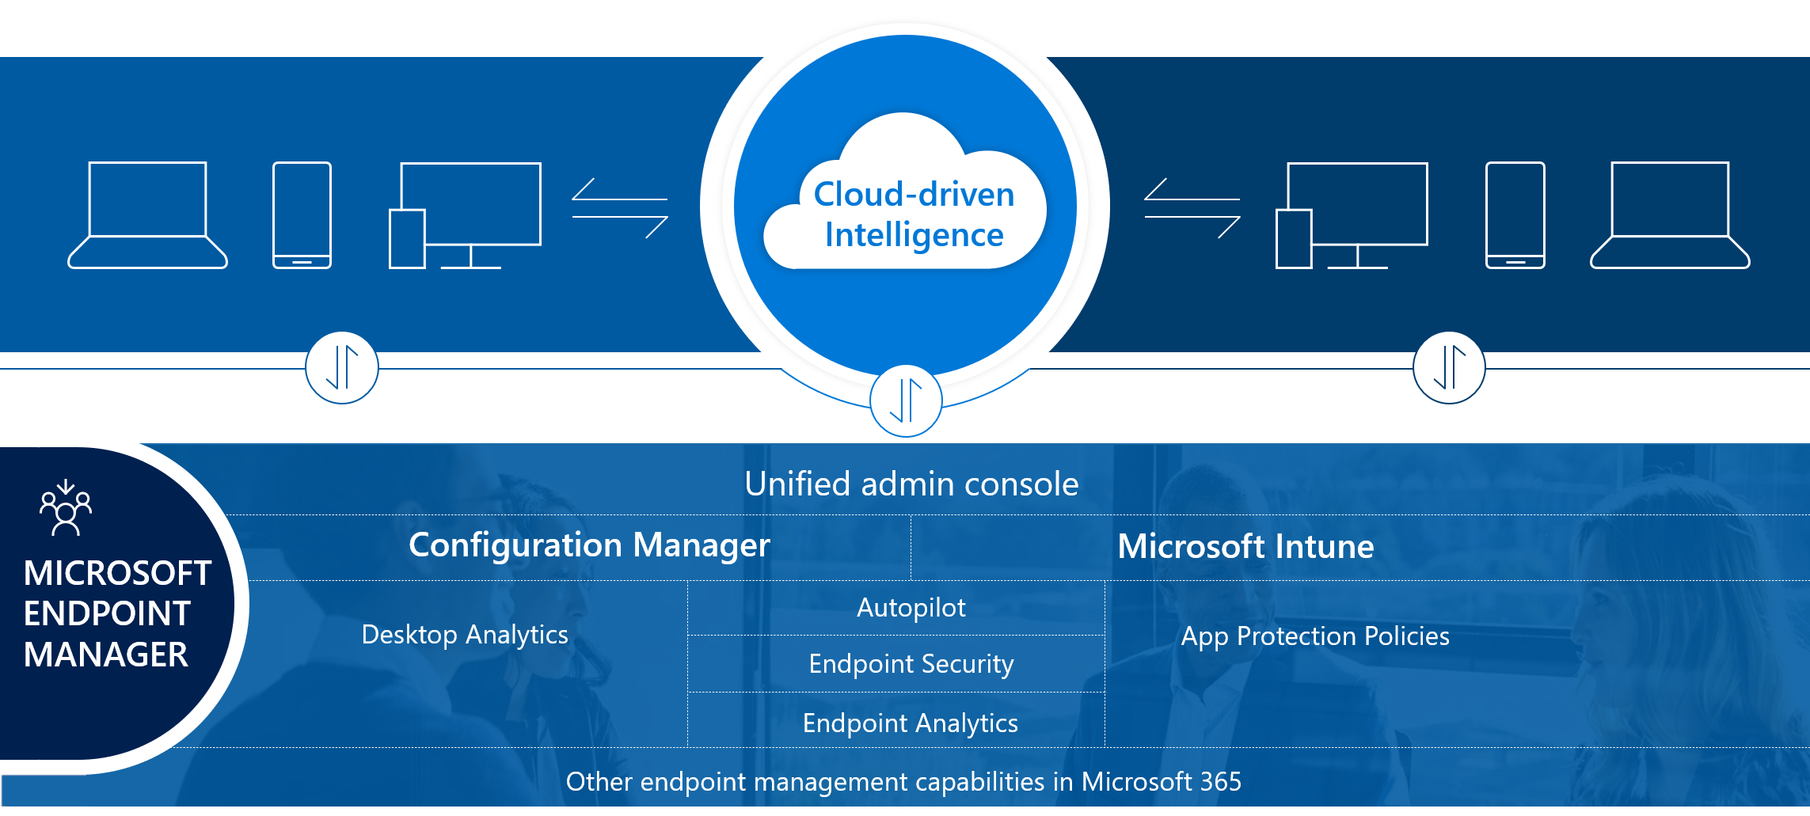
MEM – Cloud Driven Intelligence
Notes:
To quickly step through the areas of Microsoft Endpoint Manager, see Tutorial: Walkthrough Intune in Microsoft Endpoint Manager.

Slide 6

Understand Microsoft Intune

Slide 7
What is Microsoft Intune?
Let's you protect your organization by controlling features and settings on:
Android,
Android Enterprise,
iOS/iPadOS, macOS, and
Windows 10/11 devices.
Notes:
Microsoft Intune, which is a part of Microsoft Endpoint Manager, provides the cloud infrastructure, the cloud-based mobile device management (MDM), cloud-based mobile application management (MAM), and cloud-based PC management for your organization. It lets you protect your organization by controlling features and settings on Android, Android Enterprise, iOS/iPadOS, macOS, and Windows 10/11 devices. It integrates closely with Azure Active Directory (Azure AD) for identity and access control and Azure Information Protection and advanced threat protection products for data protection. When you use it with Microsoft 365, you can enable your workforce to be productive on all their devices while keeping your organization's information protected. If you have on-premises infrastructure, such as Exchange or an Active Directory, you can use Intune connectors to help you connect to external services. Intune, which is a part of Microsoft Endpoint Manager, is included in Microsoft's Enterprise Mobility + Security (EMS) suite.

Slide 8
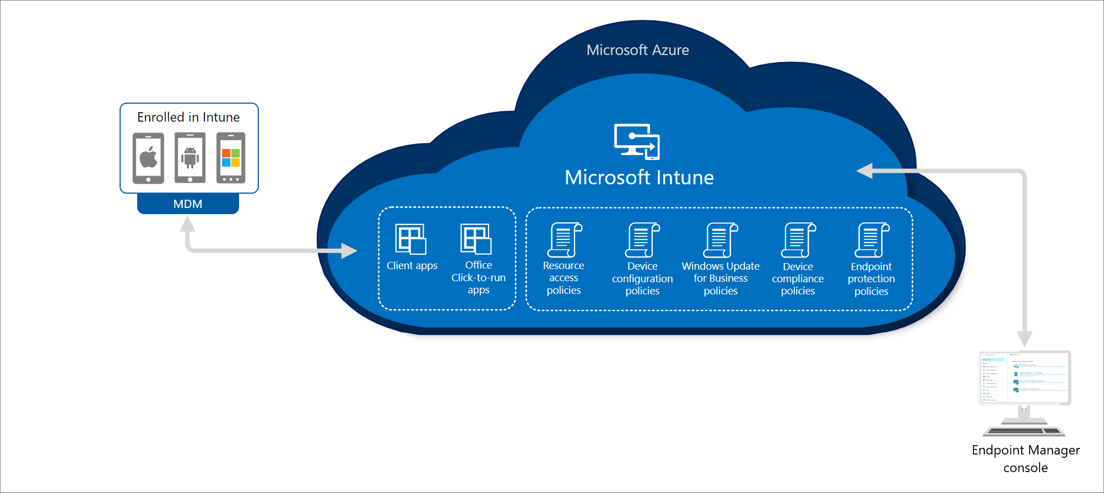
On-premises and Cloud
Notes:
In the following diagram, you can see how Intune interacts with other components in both your on-premises and cloud infrastructure:

Slide 9
Introduction to Microsoft Endpoint Configuration Manager
Lesson 2

Slide 10

Understand Microsoft Endpoint Configuration Manager

Slide 11

What is Microsoft Endpoint Configuration Manager?
Leading PC management solution on the market.
Manage
desktops,
servers, and
laptops on a network or
internet-based solution.
.
Notes:
Microsoft Endpoint Configuration Manager is the leading PC management solution on the market. You use it to manage desktops, servers, and laptops that are on your network or are internet-based. If you use Configuration Manager, you should attach your Configuration Manager deployment to the Microsoft 365 cloud, which will provide integration with Intune, Azure AD, Microsoft Defender ATP, and other cloud services. Use Configuration Manager to deploy apps, software updates, and operating systems, as well as configure sites and clients, and run and monitor management tasks. Configuration Manager supports Windows and macOS versions. The devices you manage with Configuration Manager can run in virtual environments. This includes Hyper-V on Windows servers as well as Virtual Machines (VM) in Azure. If you run a server as an Azure-based VM, you can install the Configuration Manager client on that device.

Slide 12
When to use Configuration Manager?
To use Configuration Manager,
attach your Configuration Manager deployment to the Microsoft 365 cloud,
which will:
provide integration with Intune,
Azure AD,
Microsoft Defender ATP, and
other cloud services.
Use Configuration Manager to:
deploy apps,
software updates,
operating systems,
configure sites
clients,
run and monitor management tasks.

Slide 13
What does MECM support?
Configuration Manager supports:
Windows and
macOS versions.
Device management can be:
Physical, or
Virtual
Hyper-V on Windows servers as well as Virtual Machines (VM) in Azure.
Note: If you run a server as an Azure-based VM, you can install the Configuration Manager client on that device

Slide 14
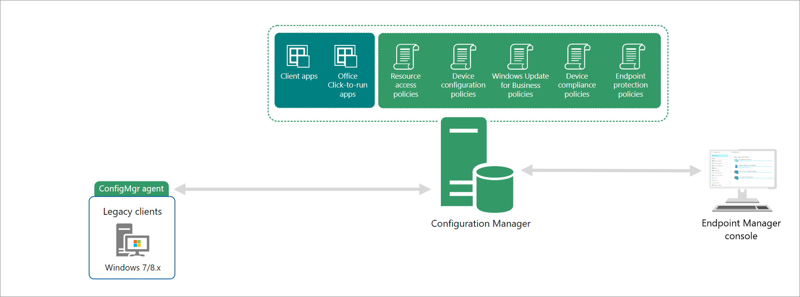
Configuration Management Architecture

Slide 15

Introduction to Cloud Attach
Lesson 3

Slide 16
What is Cloud Attach?
What is cloud attached?
Cloud attach is Configuration Manager only managed devices that show up in the cloud portal.
Notes:
Cloud attach allows you to use both Microsoft Intune and Microsoft Endpoint Configuration Manager from Microsoft Endpoint Manager.
There are two steps to cloud attach your on-premises devices. The first step of attachment is called tenant attach, which is registering your Intune tenant with your Configuration Manager deployment. The second step is called co-management, which is concurrently managing Windows 10/11 devices with both Configuration Manager and Microsoft Intune. These are incremental steps on the journey to having full cloud attachment. You get immediate value through tenant attach and you get extra value through co-management.

Slide 17
Cloud-Attaching On-Prem
Single methods, two steps:
First step of attachment is called tenant attach,
Registers On-Prem into your Intune tenant with your Configuration Manager deployment.
Second step is called co-management,
Current solution for managing Windows 10/11 devices with both Configuration Manager and Microsoft Intune.
Notes:
There are two steps to cloud attach your on-premises devices.
first step of attachment is called tenant attach, which is registering your Intune tenant with your Configuration Manager deployment.
second step is called co-management, These are incremental steps on the journey to having full cloud attachment. You get immediate value through tenant attach and you get extra value through co-management.

Slide 18
Is co-managed the same as cloud attach?
Cloud-Attach
No, Cloud attach is Configuration Manager only managed devices that show up in the cloud portal.
Co-Management
Co-management is fully managed by both Configuration Manager and Microsoft Intune with explicit admin intent on which workload is managed by either Configuration Manager or Intune.
Notes:
Co-management is fully managed by both Configuration Manager and Microsoft Intune with explicit admin intent on which workload is managed by either Configuration Manager or Intune. Cloud attach is Configuration Manager only managed devices that show up in the cloud portal.

Slide 19
What is Tenant attach?
Microsoft Endpoint Manager collects information that falls into three categories:
Identified data
Pseudonymized data
Aggregated data
Important Note: Microsoft only uses customer data to provide you the services you signed up for, Microsoft does not sell any data collected by their service to any third parties for any reason.
Notes:
Tenant attach allows you to recognize your Configuration Manager devices and infrastructure by the Intune cloud service and take actions from Microsoft Endpoint Manager. Once you connect Configuration Manager, you gain instant cloud value. Configuration Manager uses the Configuration Manager connector to enable data flow to Microsoft Endpoint Manager. It requires a connection to an Intune tenant, and doesn't require turning on co-management.
Important
The Microsoft data handling policies are described in the Microsoft Intune Privacy Statement. We only use your customer data to provide you the services you signed up for.
We don't sell any data collected by our service to any third parties for any reason.
The data is all required service data that's needed for the tenant attach connected experience. Required service data includes the following information:
Customer content, which is content you create. For example, the name of your LOB application.
Functional data, which includes information needed by a connected experience to perform its task. For example, configuration information about the app.
Service diagnostic data, which is the data necessary to keep the service secure, up to date, and performing as expected. Because this data is strictly related to the connected experience, it's separate from required or optional diagnostic data levels.

Slide 20

Introduction to Co-Management
Lesson 3

Slide 21
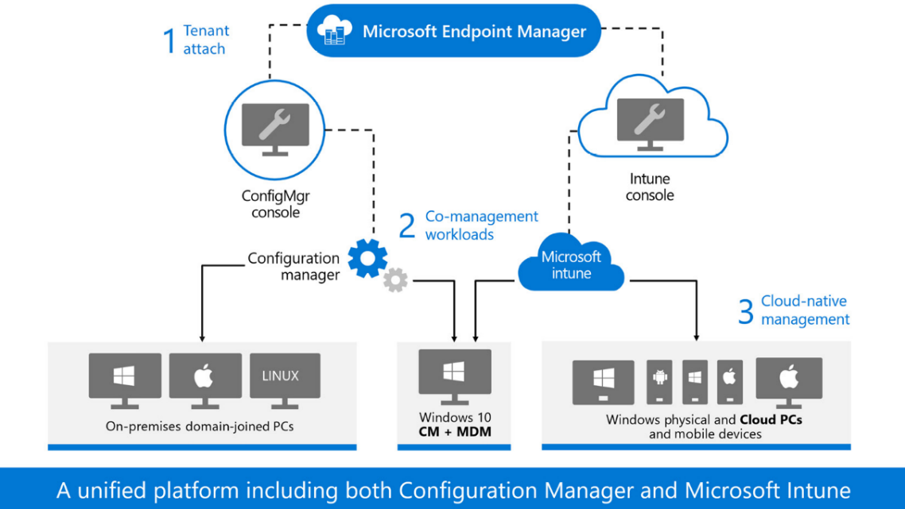

Slide 22
What is co-management?
There are two main paths to reach co-management:
Existing Configuration Manager clients
New internet-based devices
Enrollment
Conditional Access with device compliance
Intune-based remote actions, such as restart, remote control, or factory reset
Centralized visibility of device health
Link users, devices, and apps with Azure Active Directory (Azure AD)
Modern provisioning with Windows Autopilot
Notes:
Co-management is where you concurrently manage Windows 10/11 devices with both Configuration Manager and Microsoft Intune. It combines your existing on-premises Configuration Manager and Active Directory investment with the cloud by using Intune, Azure AD, and other Microsoft 365 cloud services. You choose whether Configuration Manager or Intune is the management authority. You keep some tasks on-premises, while running other tasks in the cloud with Intune.
There are two main paths to reach co-management:
Existing Configuration Manager clients: You have Windows 10/11 devices that are already Configuration Manager clients. You set up hybrid Azure AD, and enroll them into Intune.
New internet-based devices: You have new Windows 10/11 devices that join Azure AD and automatically enroll to Intune. You install the Configuration Manager client to reach a co-management state.
When you enroll existing Configuration Manager clients in co-management, you gain the following immediate value:
Conditional Access with device compliance
Intune-based remote actions, such as restart, remote control, or factory reset
Centralized visibility of device health
Link users, devices, and apps with Azure Active Directory (Azure AD)
Modern provisioning with Windows Autopilot
In the following diagram, you can see how Windows 10/11 devices can be managed with both Configuration Manager and Microsoft Intune:

Slide 23
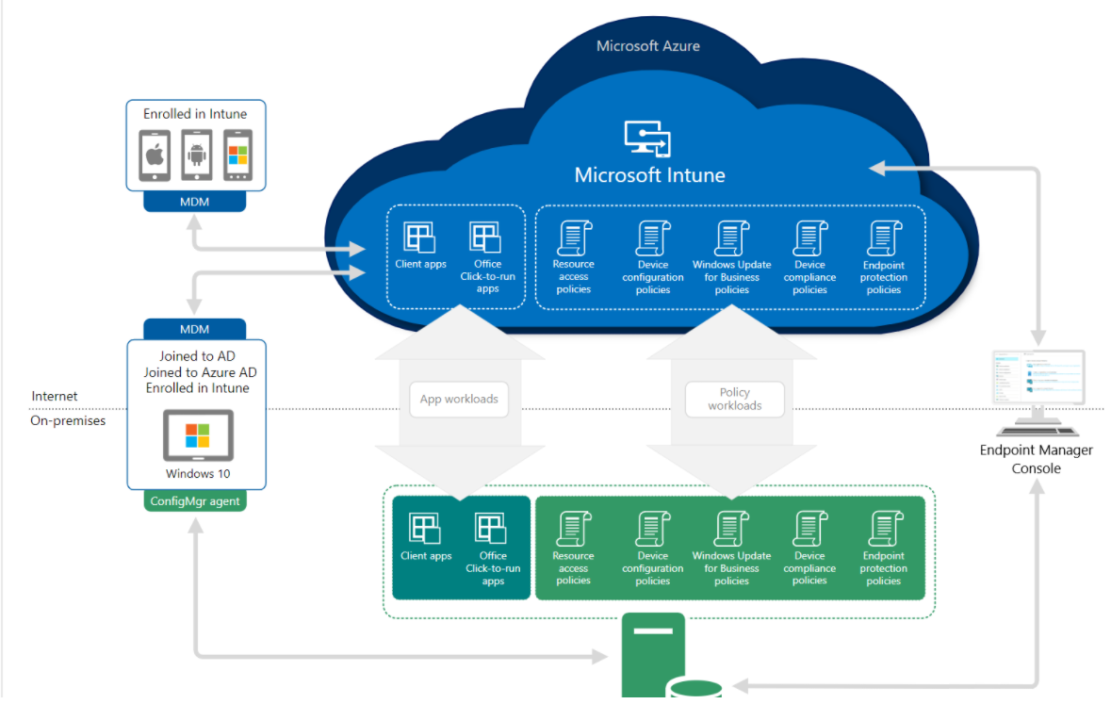
Co-management
Notes:
In the following diagram, you can see how Windows 10/11 devices can be managed with both Configuration Manager and Microsoft Intune:

Slide 24

Introduction to Analytics
Lesson 4

Slide 25

Understand Desktop Analytics
Microsoft Endpoint Manager

Slide 26
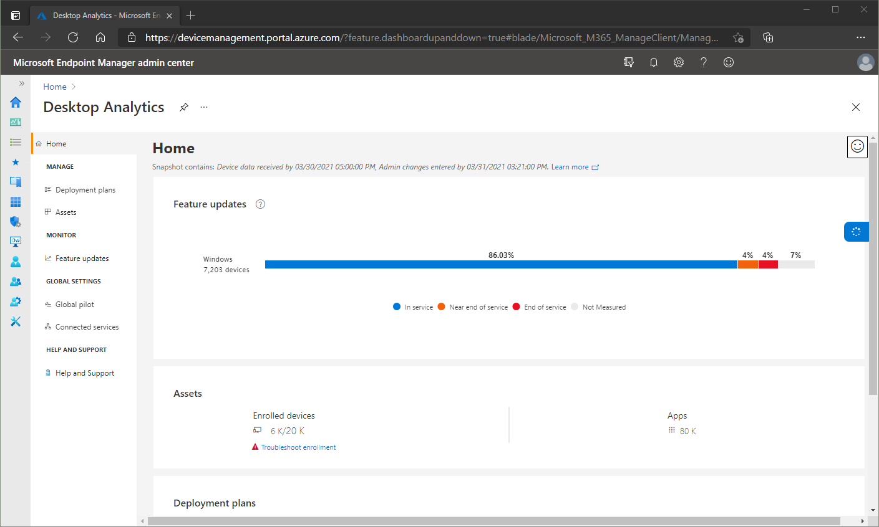
What is Desktop Analytics?
With Configuration Manager
Create an inventory of apps running in your organization
Assess app compatibility with the latest Windows 10 feature updates
Identify compatibility issues, and receive mitigation suggestions based on cloud-enabled data insights
Create pilot groups that represent the entire application and driver estate across a minimal set of devices
Deploy Windows 10 to pilot and production-managed devices
Notes:
Desktop Analytics is a cloud-based service that integrates with Configuration Manager to help you update devices. It provides insight and intelligence for you to make more informed decisions about the update readiness of your Windows clients. The service combines data from your organization with data aggregated from millions of devices connected to the Microsoft cloud. It provides information on apps, and devices in your organization, identifies compatibility issues with apps and drivers, suggest mitigations based on cloud enabled data insights, and create pilots that represent the entire application and driver state across a minimal set of devices.

Slide 27
Analytical Journey
History
Desktop analytics is a successor of Windows Analytics, which retired on January 21, 2020
Benefits
Device and software inventory
Pilot identification
Issue identification
Configuration Manager integration
Notes:
Many customers have challenges with getting and staying current with Windows 10. The primary challenge is testing applications. This process is typically manual. It's time-consuming for IT administrators and application owners to continually analyze existing applications. Then remediate any issues that arise.
Desktop Analytics provides the following benefits:
Device and software inventory: Inventory of key factors such as apps and versions of Windows.
Pilot identification: Identification of the smallest set of devices that provide the widest coverage of factors. It focuses on the factors that are most important to a pilot of Windows upgrades and updates. Making sure the pilot is more successful allows you to continue more quickly and confidently to broad deployments in production.
Issue identification: Using aggregated market data along with data from your environment, the service predicts potential issues to getting and staying current with Windows. It then suggests potential mitigations.
Configuration Manager integration: The service cloud-enables your existing on-premises infrastructure. Use this data and analysis to deploy and manage Windows on your devices.

Slide 28
Windows Analytics and the GCC
Special Attributes:
Desktop Analytics part of Azure Global
Utilizes Windows Diagnostic Data
Azure Global service available to US Government customized by implementation.
US Government Community Compliance
FedRAMP Accreditation at a High Impact level
FedRAMP artifacts must be reviewed by Federal Agency prior to implementation
Documentation certified by the Authority to Operate (ATO)
Notes:
Desktop Analytics is a Windows service hosted in Azure global that utilizes Windows diagnostic data. While Desktop Analytics is an Azure global service that's available to US government customers, it doesn't meet US Government Community Compliance (GCC) attributes. For a list of compliance offerings for Microsoft products and services, see the Microsoft Trust Center. Desktop Analytics isn't available for GCC High or US Department of Defense (DOD) customers. The use of Azure Government subscriptions to host Desktop Analytics workspaces isn't supported.
https://docs.microsoft.com/en-us/office365/servicedescriptions/office-365-platform-service-description/office-365-us-government/gcc#us-government-community-compliance

Slide 29

Endpoint analytics
Microsoft

Slide 30
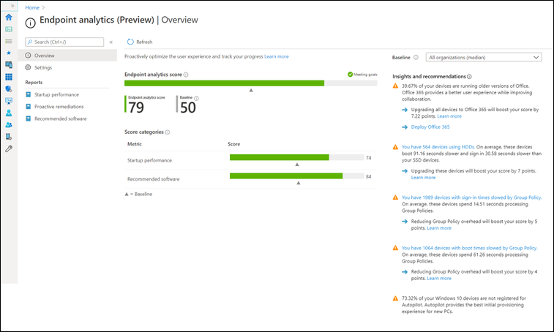
What is Endpoint analytics?
Notes:
Endpoint analytics aims to improve user productivity and reduce IT support costs by providing insights into how your organization is working and the quality of the experience you're delivering to your end users. Endpoint Analytics can help identify configuration or hardware issues that may be slowing down devices, provide recommended actions to remediate them and proactively make changes without disrupting end users or generating a help desk ticket.
Endpoint analytics is also a part of the Microsoft Productivity Score. The Productivity Score provides productivity data, insights, and recommendations for your end user's experience and your organization's overall technology experience.
The following screenshot displays the Endpoint analytics pane:

Slide 31
What is Windows Autopilot?
Windows Autopilot:
Reduces the time IT spends on deploying, managing, and retiring devices.
Reduces the infrastructure required to maintain the devices.
Maximizes ease of use for all types of end users.
Notes:
Windows Autopilot simplifies enrolling devices in Intune. You provide the enrollment details up front before the end user receives a new computer. The Windows Autopilot process runs immediately after powering on a new computer for the first time, enabling employees to configure new devices to be business-ready with just a few clicks. You can also use Windows Autopilot to reset, repurpose, and recover devices. Leveraging cloud-based services, you can automatically join devices to Azure AD, auto-enroll devices into MDM services, such as Microsoft Intune, restrict rights on the computer, auto-assign devices to configuration groups, and customize the Out-of-box-experience (OOBE) content to be specific for your organization.
By using a collection of cloud-based technologies, Windows Autopilot:
Reduces the time IT spends on deploying, managing, and retiring devices.
Reduces the infrastructure required to maintain the devices.
Maximizes ease of use for all types of end users.
From the user's perspective, it only takes a few simple operations to make their device ready to use. The only interaction required from the end user is to connect to a network and to verify their credentials. Everything beyond that is automated.

Slide 32
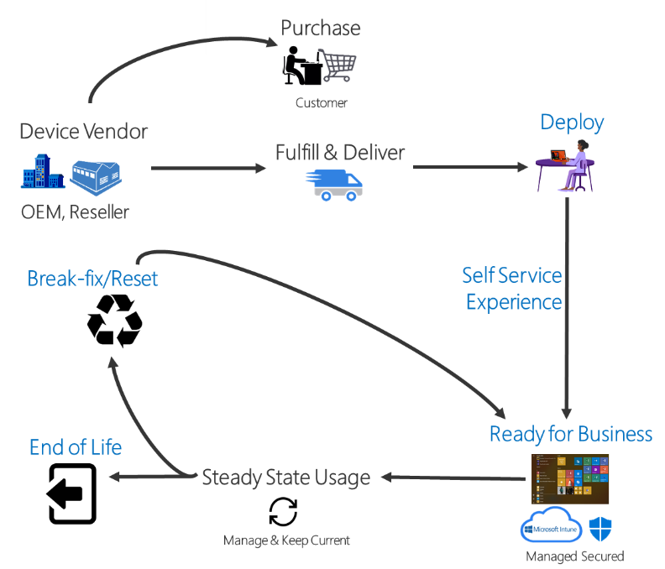
Windows Autopilot
Windows Autopilot to:
reset,
repurpose, and
recover devices.
Notes:
Windows Autopilot
Windows Autopilot is a collection of technologies used to set up and pre-configure new devices, getting them ready for productive use. Windows Autopilot can be used to deploy Windows PCs or HoloLens 2 devices. For more information about deploying HoloLens 2 with Autopilot, see Windows Autopilot for HoloLens 2.

Slide 33
Knowledge Check
What does Microsoft Endpoint Manager provide for an organization?
Endpoint Manager helps keep an organization's cloud and on-premises devices, apps, and data secure.
Endpoint Manager ensures an organization no longer needs credentials to access and share company data.
Endpoint Manager prevents remote devices and apps from accessing an organization's resources.
What are endpoints?
Endpoints are the policies that the users and groups of an organization use to safely transfer data.
Endpoints are the end-users of an organization.
Endpoints include mobile devices, desktop computers, servers, and apps that an organization uses.
What is co-management as it applies to Microsoft Endpoint Manager?
Co-management describes how an organization can concurrently manage Windows 10/11 devices using both Configuration Manager and Microsoft Intune.
Co-management describes how an organization can manage non-Windows devices at an organization using Microsoft 365, BitLocker, and Azure Active Directory.
Co-management describes how company owned devices can be managed without using cloud-based services.
Notes:
A
C
A

Slide 34

Introduction to Connectors and Tenant Attach
Module 3

Slide 35
Connectors
Lesson 2

Slide 36

Endpoint Manager services
Intune connectors are also available:
The Intune Connector for Active Directory adds entries to your on-premises Active Directory domain for computers that enroll using Windows Autopilot.
Note: For more information, read the article: “Deploy hybrid Azure AD-joined devices.”
The Intune certificate connector processes certificate requests from devices that use certificates for authentication and S/MIME email encryption.
Note: For more information, read the article: “Use certificates for authentication.”

Slide 37
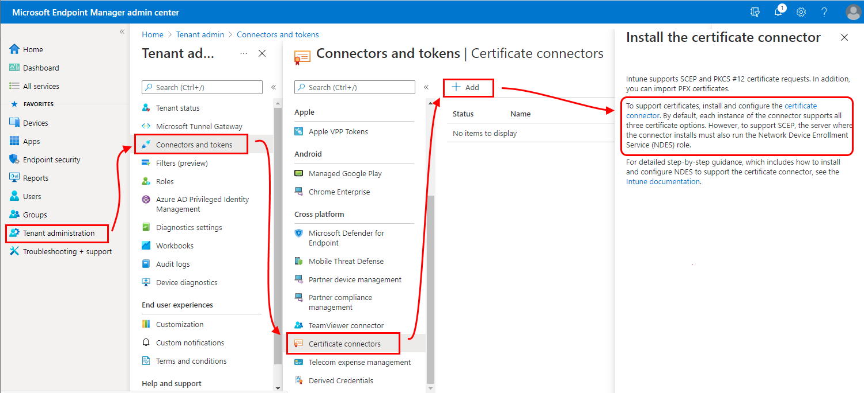
MEM Connectors
Figure 9: MEM Admin Center - Tenant Administration

Slide 38
Summary
In this module, you've learned about Microsoft Endpoint Manager, what it is, and its key services.
Here are some of the things you covered:
Endpoint Manager is used to manage an organization's endpoints. Endpoints include mobile devices, desktop computers, and servers that an organization uses. Additionally, endpoints also include the apps used by an organization. These endpoints are managed in different environments based on where these endpoints are located.
Endpoint Manager helps you manage and protect your organization against advanced digital threats, while still being productive.
By implementing a management infrastructure, you can provide IT services, apps, protection, and configuration to your end users to make them extremely productive.
Endpoint Manager integrates Microsoft Intune, Microsoft Endpoint Configuration Manager, Desktop Analytics, Endpoint analytics and Windows Autopilot.
Notes:
In this module, you've learned about Microsoft Endpoint Manager, what it is, and its key services.
Here are some of the things you covered:
Endpoint Manager is used to manage an organization's endpoints. Endpoints include mobile devices, desktop computers, and servers that an organization uses. Additionally, endpoints also include the apps used by an organization. These endpoints are managed in different environments based on where these endpoints are located.
Endpoint Manager helps you manage and protect your organization against advanced digital threats, while still being productive.
By implementing a management infrastructure, you can provide IT services, apps, protection, and configuration to your end users to make them extremely productive.
Endpoint Manager integrates Microsoft Intune, Microsoft Endpoint Configuration Manager, Desktop Analytics, Endpoint analytics and Windows Autopilot.

Slide 39
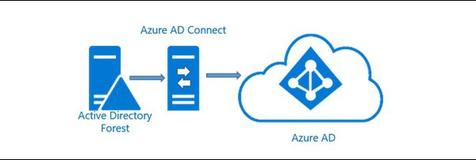
Azure Active Directory Connector?
Figure 12: Azure AD Connect Integration
Notes:
Figure 12: Azure AD Connect Integration
Azure Active Directory (AD): Azure AD is used by Endpoint Manager for the identity of devices, users, groups, and multi-factor authentication (MFA). Azure AD Premium, which may be an additional cost, has additional features to help protect devices, apps, and data, including dynamic groups, auto-enrollment, and conditional access.

Slide 40
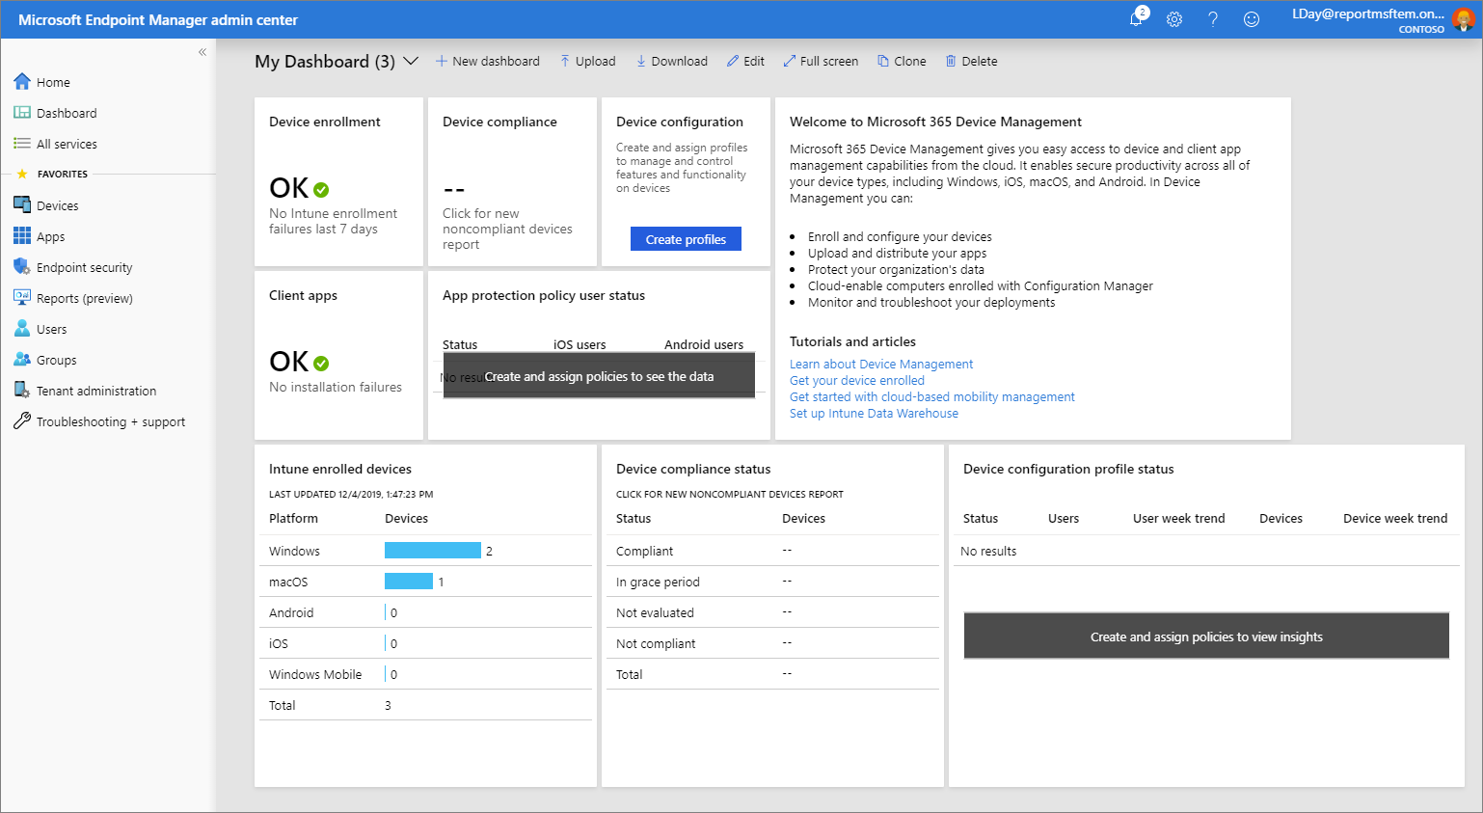
Endpoint Manager Admin Center
If you constantly provision new devices, then start with Windows Autopilot.
If you add rules and control settings for your users, apps, and devices, then start with Intune.
If you currently use Configuration Manager to deploy apps and use conditional access based on security requirements, then start with co-management.
If you currently use Configuration Manager and are responsible for keeping Windows 10 devices up-to-date, start with Desktop Analytics.
Notes:
Endpoint Manager admin center: The admin center is a one-stop website to create policies and manage your devices. It plugs in other critical device management services, including groups, security, conditional access, and reporting. This admin center also shows devices managed by Configuration Manager and Intune (in preview).
<$SCR_H::2>CHOOSE WHAT'S RIGHT FOR YOU<!$SCR_H::2>
There are a few ways to determine what's suitable for your organization. Your next steps depend on what your organization does. First, consider what you're trying to achieve. For example:
If you constantly provision new devices, then start with Windows Autopilot.
If you add rules and control settings for your users, apps, and devices, then start with Intune.
If you currently use Configuration Manager to deploy apps and use conditional access based on security requirements, then start with co-management.
If you currently use Configuration Manager and are responsible for keeping Windows 10 devices up-to-date, start with Desktop Analytics.
Figure 13: MEM Admin Center Dashboard
If you're getting started with MDM and MAM, or use ADMX templates to control Office, Microsoft Edge, and Windows settings, then start with Intune.

Slide 41
Endpoint Manager Structure
ZERO-TRUST
OVER-THE-AIR
CLOUD DATA protection
PASSWORDLESS AUTHENTICATION model
ZERO TOUCH PROVISIONING
REMOTE SUPPORT
On-premises
Notes:
ZERO-TRUST
Zero-trust assumes all devices are untrusted and cannot access company resources until proven otherwise. This is typically achieved through device attestation, the use of conditional access policies, and through multi-factor authentication.
OVER-THE-AIR
Windows update management is based on deployment rings. Set the maximum deferral period for semi-annual feature updates and monthly quality updates with security updates. Patch management is no longer required for operating systems.
CLOUD DATA protection
Eliminate the need to manage on-premise storage infrastructure. Gain live document collaboration, automatic backups, and drop your VPN.
PASSWORDLESS AUTHENTICATION model
Use cloud identity, single-sign-on and biometrics to remove the liability of password management for knowledge workers. Employees will love not having to remember passwords and phishing attacks will be virtually eliminated.
ZERO TOUCH PROVISIONING
Stop imaging laptops. Ship devices directly to employees and get remote setup and configuration for all your devices.
REMOTE SUPPORT
Purposefully designed for remote employees, with a mobile app, self-service options, 24x7 coverage and rapid response SLAs.
Modern Endpoint Management is designed to reduce cost, improve security and delight employees. All this is enabled by Microsoft 365 and world-class support from Mobile Mentor.
Cloud
All data is stored in Azure. And, no more data centers. This approach gives you the mobility benefits of the cloud and the security benefits of Azure.
On-premises
If you have an on-premises infrastructure that includes Configuration Manager, or aren't ready to use the cloud, then you can keep your existing systems.

Slide 42

Primary features
Choose what is right for you!
Configuration Manager integration
Co-management
Windows Autopilot
Endpoint Manager admin center
Notes:
Configuration Manager is an on-premises management solution to manage desktops, servers, and laptops that are on your network or internet-based. You can cloud-enable it to integrate with Intune, Azure Active Directory (AD), Microsoft Defender for Endpoint, and other cloud services. Use Configuration Manager to deploy apps, software updates, and operating systems. You can also monitor compliance, query and act on clients in real time, and much more. As part of Endpoint Manager, continue to use Configuration Manager as you always have. If you're ready to move some tasks to the cloud, consider co-management.
Note: For more information, see What Is Configuration Manager?

Slide 43
Choose what is right for you!
For example:
If you constantly provision new devices, then start with Windows Autopilot.
If you add rules and control settings for your users, apps, and devices, then start with Intune.
If you currently use Configuration Manager to deploy apps and want to use conditional access based on security requirements, then start with co-management.
If you currently use Configuration Manager and are responsible for keeping Windows 10 devices up-to-date, then start with Desktop Analytics.
If you're getting started with MDM and MAM, or use ADMX templates to control Office, Microsoft Edge, and Windows settings, then start with Intune.

Slide 44
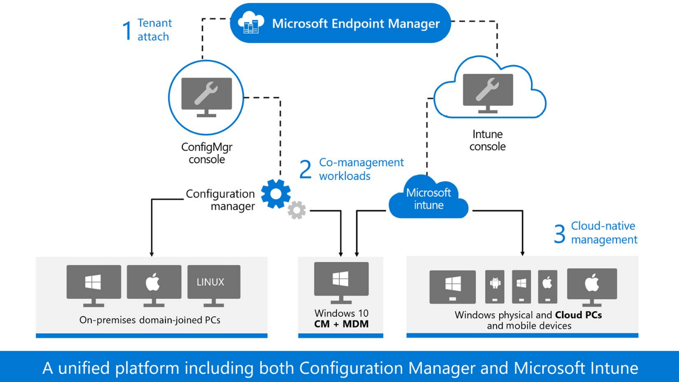
Choose what is right for you!
Endpoint Manager in three parts:
Cloud Only
On-premises Only
Hybrid (Cloud-On-premises)
Figure 14: Microsoft Unified Endpoint Manager Architecture
Notes:
You can also think of Endpoint Manager in three parts: cloud, on-premises, and cloud + on-premises:
Cloud Only
All data is stored in Azure. And, no more data centers. This approach gives you the mobility benefits of the cloud and the security benefits of Azure.
On-premises Only
If you have an on-premises infrastructure that includes Configuration Manager, or aren't ready to use the cloud, then you can keep your existing systems.
Hybrid (Cloud-On-premises)
Many environments are mixed, and use a cloud-attach approach. Meaning they use a combination of cloud and on-premises. For new devices, use the benefits of Intune to access and protect data. If you use Configuration Manager, connect to the cloud for additional functionality and analytics. If you want to move some workloads to the cloud, then co-management is a good option.
Microsoft Endpoint Manager and Intune
What is unified endpoint management and how does this look through the concept of Microsoft Endpoint Manager? The following high-level architecture drawing explains how everything within Microsoft Endpoint Manager comes together in one unified endpoint management experience.
There is one console for your physical and cloud PCs via Windows 365 endpoints and mobile devices. This is the only place where they can be managed in a unified way. Also, the Intune company portal can deploy apps from Configuration Manager, Intune, Windows 365, Azure Virtual Desktop, and Azure Active Directory – one end user experience for all apps!
Figure 14: Microsoft Unified Endpoint Manager Architecture
The Microsoft Endpoint Manager architecture in the preceding diagram shows the three stages of the cloud management journey using Configuration Manager and Intune in a single, unified endpoint management solution:

Slide 45
Tenant Attach
Lesson

Slide 46
What is Tenant Attach
Co-management workloads
Cloud-native management
Notes:
Tenant attach
Co-management workloads
Cloud-native management
All new Windows devices should go directly to the cloud with Azure Active Directory (Azure AD) with automatic enrollment into Intune. This leverages Windows Autopilot for the best onboarding experience for IT and end users, provided your organization already has a Configuration Manager environment with lots of applications that you are deploying to your on-premises managed devices.
For existing devices, start using tenant-attach capabilities that provide the most flexible path for Configuration Manager customers to start gaining cloud benefits without necessarily enrolling their Windows clients with Intune. Connect the Configuration Manager environment to the cloud and immediately access a host of remote actions and endpoint analytics.
If your organization is ready for the next step, you can start onboarding Windows devices into a co-management state, which means managing Windows clients using both Configuration Manager and Intune. Leverage the best of both worlds by moving one workload to the cloud at a time.

Slide 47
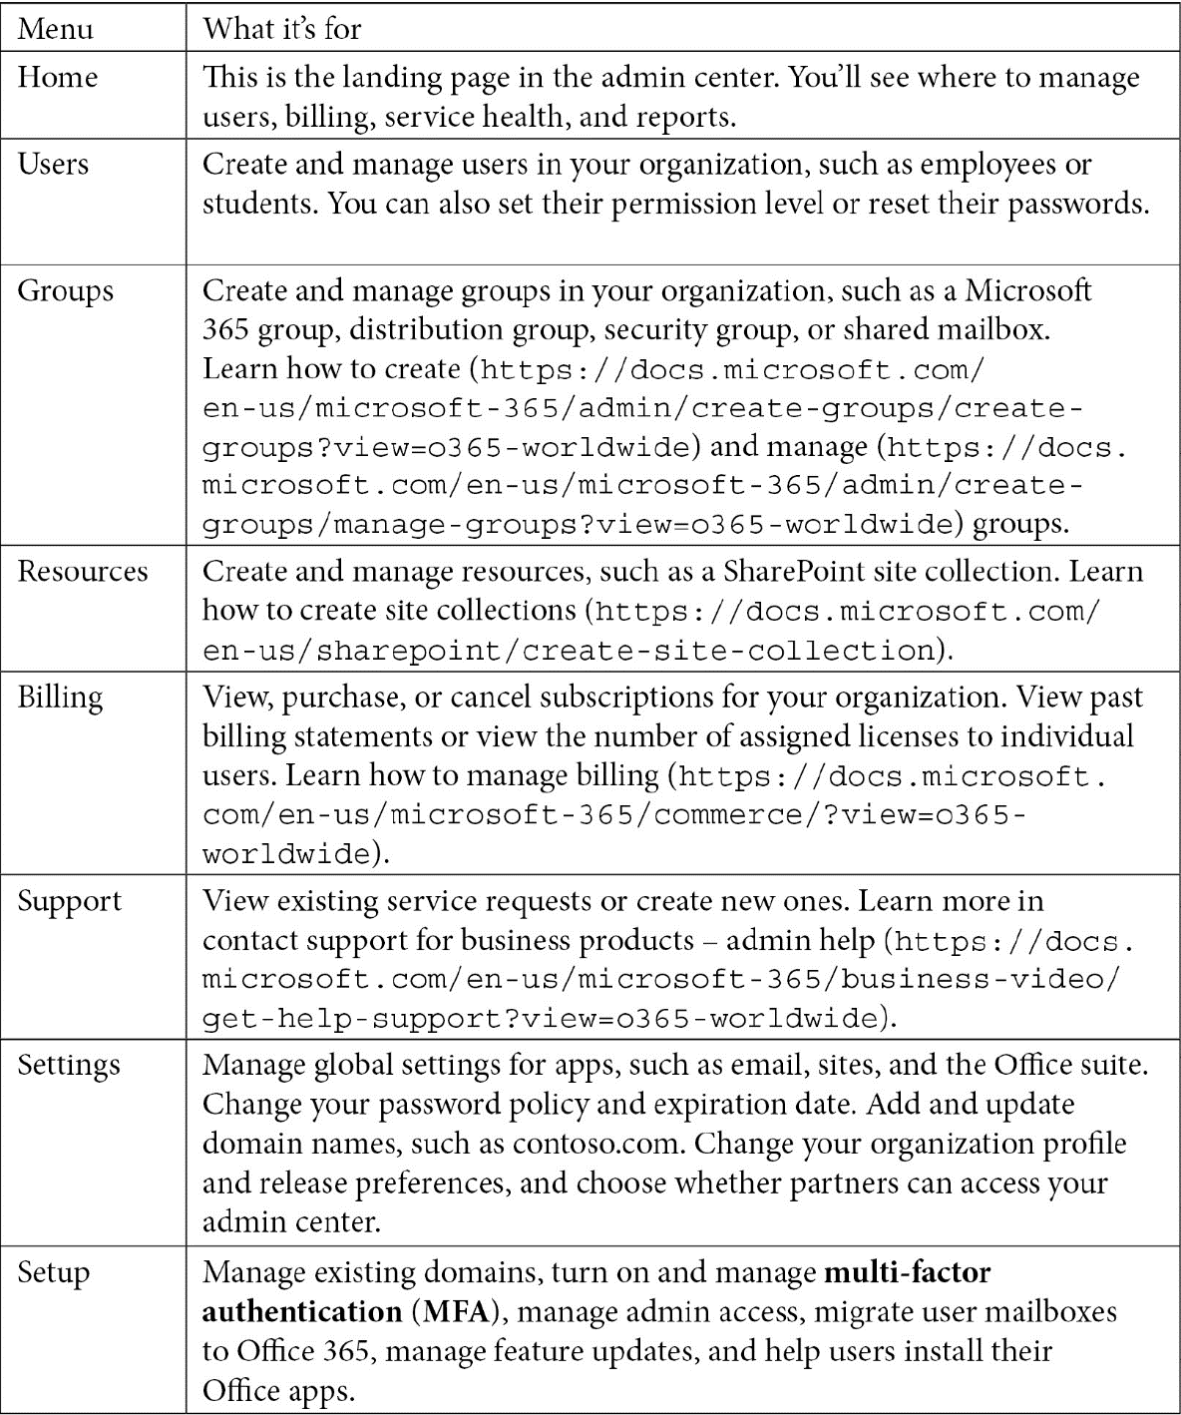
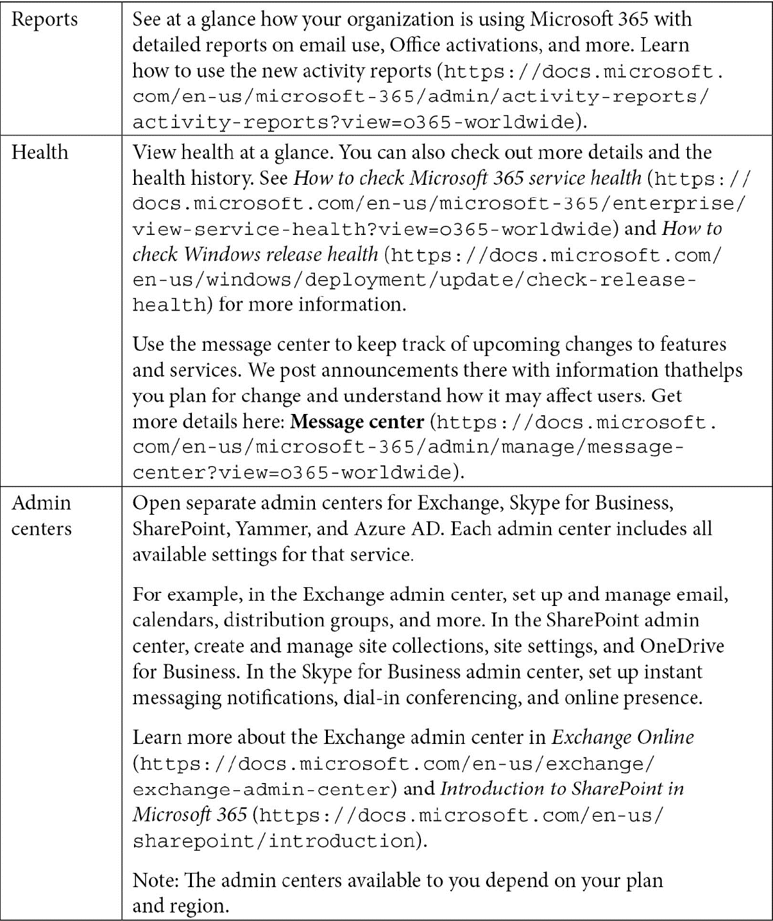
Endpoint Manager admin center portal
Cloud PC/Windows 365
Azure Active Directory (Azure AD)
Notes:
Here's a full list of what you can do via the Microsoft 365 admin center:
Table 3: Administration Scopes and Reports
Cloud PC/Windows 365
Windows 365 is everything you need when you are looking for a simplified way of running your Windows desktops in the cloud. It brings decreased costs, while lowering the complexity level of your environment as you deploy and manage virtual endpoints in Microsoft Endpoint Manager; no additional Virtual Desktop Infrastructure (VDI) expertise or resources are required. More on this will follow later in this chapter.
Azure Active Directory (Azure AD)
Azure AD is the main identity used by Endpoint Manager to manage your devices, users, and groups to perform advanced Conditional Access capabilities, such as MFA and compliance-based filtering. With Azure AD Premium, you can add several additional features to help protect devices, apps, and data, including dynamic groups, autoenrollment, and Conditional Access.

Slide 48
Integrates and Unifies
Configuration Manager
Cloud management gateway (CMG)
Co-management workloads:
Compliance policies
Windows Update policies
Resource access policies
Endpoint protection
Device configuration
Office Click-to-Run apps
Client apps
Compliance policies
Windows Update policies

Slide 49
Cont. Integrates and Unifies
Resource access policies
Endpoint protection
Antivirus:
Disk encryption
Firewall
Endpoint detection and response
Attack surface reduction
Notes:
Resource access policies
Resource access policies configure virtual private network (VPN), Wi-Fi, email, and certificate settings on Windows 10 and later devices.
Endpoint protection
The endpoint protection workload includes the Windows Defender suite of anti-malware protection features:
Antivirus: Antivirus policies help security admins focus on managing the settings for Microsoft Defender Antivirus, Microsoft Defender exclusions, and the Windows Security experience as a policy for Intune-managed devices.
Disk encryption: Endpoint security disk encryption profiles focus on only the settings that are relevant for a device's built-in encryption method, such as BitLocker. This makes it possible for an IT admin to deploy and automatically encrypt end users' Windows devices.
Firewall: Use the endpoint security firewall policy in Intune to configure a device's built-in firewall for devices that run Windows 10. Firewall policies are divided into two, the firewall policy itself and a firewall rule policy.
Endpoint detection and response: When you integrate Microsoft Defender for Endpoint with Intune, use the endpoint security policies for endpoint detection and response (EDR) to manage the EDR settings and onboard devices for Microsoft Defender for Endpoint.
Attack surface reduction: When Defender Antivirus is in use on your Windows 10 devices, use Intune endpoint security policies for attack surface reduction to manage those settings for your devices.

Slide 50
Attack surface reduction policy
Divided into isolated policies:
App and browser isolation
Device control
Attack surface reduction rules
Exploit protection
Web protection for Microsoft Edge Legacy
Application control

Slide 51
Integration and Unification
Account protection
Device configuration
Office Click-to-Run apps
Client apps
Desktop Analytics
Windows Autopilot
Notes:
Account protection
Account protection policies help you protect the identity and accounts of your users. The account protection policy is focused on settings for Windows Hello and Credential Guard, which is part of Windows identity and access management.
When you switch this workload, the Configuration Manager policies stay on the device until the Intune policies overwrite them. This behavior makes sure that the device still has protection policies during the transition.
The endpoint protection workload is also part of device configuration. The same behavior applies when you switch the device configuration workload. When you switch the device configuration workload, it also includes policies for the Windows Information Protection feature, which isn't included in the endpoint protection workload.
The Microsoft Defender Antivirus settings that are part of the device restrictions profile type for Intune device configuration are not included in the scope of the Endpoint protection slider. To manage Microsoft Defender Antivirus for co-managed devices with the endpoint protection slider enabled, use the new Antivirus policies in Microsoft Endpoint manager admin center | Endpoint security | Antivirus. The new policy type has new and improved options available and supports all the same settings available in the device restrictions profile.
The Windows encryption feature includes BitLocker management. We will talk more about BitLocker in the Advanced Policy Management chapter, and in the Identity and Security Management.
Device configuration
The device configuration workload includes settings that you manage for devices in your organization. Switching this workload also moves the resource access and endpoint protection workloads.
Even though Intune is the device configuration authority, you can still deploy settings from Configuration Manager to co-managed devices. This exception might be used to configure your organization's settings but aren't yet available in Intune. Specify this exception on a Configuration Manager configuration baseline. Enable the option to always apply this baseline even for co-managed clients when creating the baseline. You can change it later in the General tab of the properties of an existing baseline.
For more information on the Intune feature, refer to the Create a device profile in Microsoft Intune.
Office Click-to-Run apps
This workload manages Microsoft 365 apps on co-managed devices. Remember that when moving Microsoft 365 apps that work in Microsoft Intune for existing System Center Configuration Manager (SCCM)-managed devices, you should not automatically change Microsoft 365 app updates to cloud updates from Content Delivery Network (CDN). Updates can be managed using administrative templates in Microsoft Intune.
Office updates may take around 24 hours to show up at clients unless the devices are restarted.
Office 365 applications are managed by Intune. This condition in Intune is added by default as a requirement to new Microsoft 365 applications. When you transition this workload, co-managed clients don't meet the requirements of the application, and then they don't install Microsoft 365 deployed via Configuration Manager. After moving the workload, Microsoft 365 apps assigned from Microsoft Intune show up in the company portal on the device. (Microsoft - Aaron Czechowski and others, 2022)
Client apps
Use Intune to manage client apps and PowerShell scripts on co-managed Windows 10 devices. After you transition this workload, any available apps deployed from Intune are available in the company portal. Apps that you deploy from Configuration Manager are available in the software center and company portal. The company portal can show both SCCM and Intune available apps as one end user software portal.
Desktop Analytics
Desktop Analytics is a cloud-based service that integrates with Configuration Manager. It provides insight and intelligence for you to make more informed decisions about the update readiness of your Windows clients. The service combines data from your organization with data aggregated from millions of devices connected to the Microsoft cloud. It provides information on security updates, apps, and devices in your organization, and identifies compatibility issues with apps and drivers. Create a pilot for devices most likely to provide the best insights for assets across your organization.
As part of Endpoint Manager, use the cloud-powered insights of Desktop Analytics to keep Windows 10 devices current. Desktop Analytics needs an SCCM client on the devices, and Intune alone is not supported.
Windows AutopiloT
Windows Autopilot sets up and pre-configures new devices, getting them ready for use. It is designed to simplify the life cycle of Windows devices, for both IT and end users, from initial deployment through to end of life.
As part of Endpoint Manager, use Autopilot to preconfigure devices and automatically enroll devices in Intune. You can also integrate Autopilot with Configuration Manager and co-management for more complex device configurations (in preview).

Slide 52
Integration and Unification
Azure AD
Client details
Install applications
Device timeline
Resource Explorer
Run scripts
Notes:
Azure AD
Azure AD is used by Endpoint Manager to identify devices, users, groups, and MFA. Azure AD Premium, which is part of the Microsoft 365 license, has additional features to help protect devices, apps, and data, including dynamic groups, autoenrollment, and Conditional Access. Azure AD Premium is also required for Windows Autopilot as automatic enrollment is a pre-requisite.
Endpoint Manager admin center: The admin center is a one-stop website to create policies and manage your devices. It plugs into other key device management services, including groups, security, Conditional Access, and reporting.
Microsoft Endpoint Manager is an integrated solution for managing all of your devices. Microsoft brings together Configuration Manager and Intune into a single console called the Microsoft Endpoint Manager admin center.
Starting in Configuration Manager version 2002, you can upload your Configuration Manager devices to the cloud service and take action from the Devices blade in the admin center:
Client details
This feature gives the IT admin or helpdesk a fast overview of properties and the state of devices.
Install applications
This feature gives the IT admin or helpdesk the option to deploy an application to the end users' devices.
Device timeline
Devices send events once a day to the admin center. Only events collected after the client receives the Enable Endpoint analytics data collection policy are visible in the admin center. Generate test events easily by installing an application or an update from Configuration Manager, or restart the device. Events are kept for 30 days. Use the chart to view events that are collected.
Resource Explorer
From the Microsoft Endpoint Management admin center, you can view the hardware inventory for uploaded Configuration Manager devices by using Resource Explorer.
Run scripts
This option allows additional IT admins or the helpdesk to run PowerShell scripts from the cloud against an individual Configuration Manager-managed device in real time. This provides all the traditional benefits of PowerShell scripts that have already been defined and approved by the Configuration Manager admin in the on-premises environment.

Slide 53
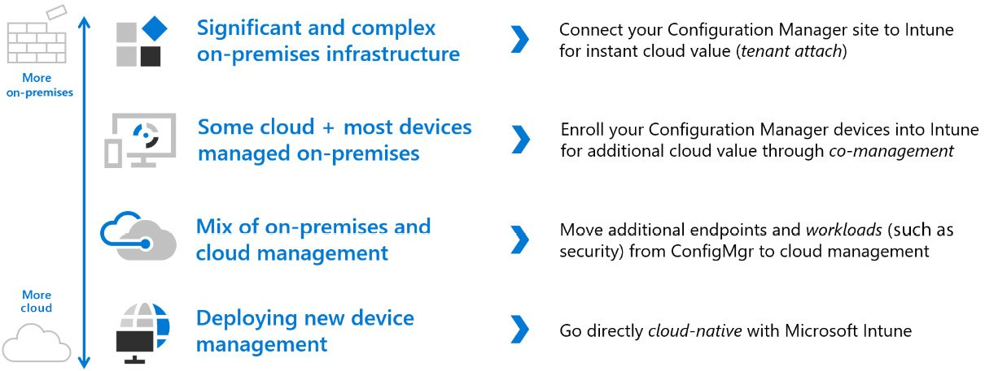
Microsoft Endpoint Manager
From On-premises to the Cloud
Notes:
Microsoft Endpoint Manager – from on-premises to the cloud
The unified endpoint management journey is different for each customer. Some customers are using some components of Microsoft Endpoint Manager already, and so the migration is relatively easy.
Figure 16: Microsoft Endpoint Manager – on-premises-to-cloud flow
If you are still using complex on-premises infrastructures, the work could be a bit more intense. It's fully dependent on the complexity of your current environment.

Slide 54
Exploring Windows 10 Enterprise in detail
Enterprise features and services:
Intelligent security
Credential protection
Endpoint detection and response
Unified Write Filter (UWF)
Simplified updates:
30 months of support for September-targeted releases
Windows 10 Long-Term Servicing Channel
Desktop analytics
Flexible management:
Azure Virtual Desktop use rights
Microsoft User Experience Virtualization (UE-V)
Microsoft Application Virtualization (App-V)
Microsoft FSLogix Profile Container
Enhanced productivity:
SMB Direct
Persistent memory
Support for other Microsoft 365 services:
Azure Virtual Desktop
Windows 365
Universal Print

Slide 55
Windows activation
Paths available:
A key management service
A multiple activation key
An Active Directory-based activation
A Windows 10 subscription activation
Notes:
First, we will cover how to transform a Windows 10 Pro instance into an Enterprise version in the cloud without reimaging. In the past, when organizations were deploying Windows at scale with an OS deployment tool such as Microsoft Deployment Toolkit (MDT) or Microsoft Endpoint Manager Configuration Manager, the IT admin needed to deploy the correct Windows version of Pro or Enterprise.
The most common methods of volume activation require that devices be connected to an organization's network or connected via the VPN to check in from time to time with the organization's activation service to maintain their licenses. However, when people work from home and off the corporate or school networks, their devices' ability to receive or maintain activation is limited.

Slide 56
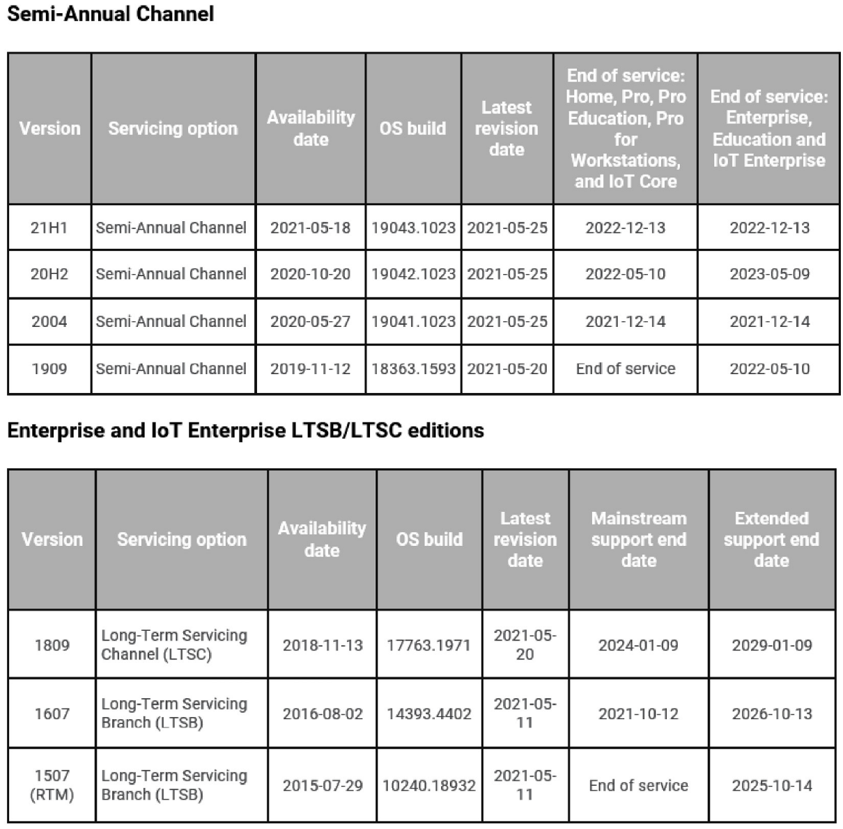
Activation Method
Via a Windows 365 cloud PC
Azure KMS – cloud PC/Windows 365/AVD
Key Management Service
Multiple activation key
Active Directory-based activation
Windows 10 and later Subscription Activation
Windows 10, version 1703 or later
Windows as a Service – update release cycle
Figure 17: Windows 10 Enterprise release diagram
Notes:
Using Windows via a Windows 365 cloud PC
The preceding options to activate Windows 10 Enterprise are built into a Windows 365/cloud PC. If you are going to self-manage and deploy virtual desktops on Azure, this means that Windows 10 Enterprise will be automatically activated via Azure Key Management Service (KMS).
Azure KMS – cloud PC/Windows 365/AVD
If your Windows desktops are virtual and run on Azure such as with Azure Virtual Desktop (AVD), you need to connect to the Azure kms.core.windows.net:1688 KMS server in order to activate your virtual machine. This happens automatically when using images from the Azure image gallery. Make sure that your Azure virtual network (vNET) can connect to this address, and configure your firewall policies and rules accordingly. You will learn more about this later on in the cloud PC/Windows 365 and requirements chapters. Windows 11 will be added later this fall to the offering once the OS is made generally available. More on Windows 11 is covered later on in the book.
Key Management Service
KMS activation requires TCP/IP connectivity to, and accessibility from, an organization's private network so that licenses are not accessible to anyone outside of the organization. By default, KMS hosts and clients use DNS to publish and find the KMS key. Default settings can be used, which require little or no administrative action, or KMS hosts and client computers can be manually configured based on network configuration and security requirements.
KMS activations are valid for 180 days (the activation validity interval). KMS client computers must renew their activation by connecting to the KMS host at least once every 180 days. By default, KMS client computers attempt to renew their activation every 7 days. If KMS activation fails, the client computer tries to reach the host every 2 hours. After a client computer's activation is renewed, the activation validity interval begins again.
Multiple activation key
A multiple activation key (MAK) is used for one-time activation with Microsoft's hosted activation services. Each MAK has a predetermined number of activations allowed. This number is based on volume licensing agreements, and it might not match the organization's exact license count. Each activation that uses an MAK with the Microsoft-hosted activation service counts toward the activation limit. (Microsoft - Erik Reitan and others, 2021)
You can use an MAK for individual computers or with an image that can be duplicated or installed using Microsoft deployment solutions. You can also use an MAK on a computer that was originally configured to use KMS activation, which is useful for moving a computer from the core network to a disconnected environment.
Active Directory-based activation
Active Directory-based activation is like KMS activation but uses Active Directory instead of a separate service. Active Directory-based activation is implemented as a role service that relies on Active Directory Domain Services to store activation objects. Active Directory-based activation requires that the forest schema be updated using adprep.exe on a supported server OS, but after the schema is updated, older domain controllers can still activate clients.
Devices activated via Active Directory maintain their activated state for up to 180 days following the most recent contact with the domain. Devices periodically attempt to reactivate (every 7 days by default) before the end of that period and, again, at the end of the 180 days.
Windows 10 and later Subscription Activation
Starting with Windows 10, version 1703, Windows 10 Pro supports the Subscription Activation feature, enabling users to step up from Windows 10 Pro to Windows 10 Enterprise automatically if they are subscribed to Windows 10 Enterprise E3 or E5.
With Windows 10, version 1703, both Windows 10 Enterprise E3 and Windows 10 Enterprise E5 are available as online services via subscription. Deploying Windows 10 Enterprise in your organization can now be accomplished with no keys and no reboots. (Microsoft, 2022)
Windows 10, version 1703 or later
Devices with a current Windows 10 Pro license can be seamlessly upgraded to Windows 10 Enterprise. Product key-based Windows 10 Enterprise software licenses can be transitioned to Windows 10 Enterprise subscriptions.
Organizations that have an Enterprise agreement can also benefit from the new service, using traditional Active Directory-joined devices. In this scenario, the Active Directory user that signs in on their device must be synchronized with Azure AD using Azure AD Connect sync.
The Subscription Activation feature eliminates the need to manually deploy Windows 10 Enterprise or Education images on each target device and then later standing up on-premises key management services, such as KMS- or MAK-based activation, entering Generic Volume License Keys ( GVLKs), and subsequently rebooting client devices.
Windows as a Service – update release cycle
Windows updates are released every 6 months, somewhere around March and September, via the Semi-Annual Channel release cycle. Every month, quality updates are released, depending on the life cycle policy:

Slide 57
What is WUfB?
Microsoft's preferred update Mechanism
WUfB is the new way of manning Windows servicing
WUfB used cloud-based Windows Update service to deploy and manage Windows updates.
Based on Group Policy or MDM solutions such as Microsoft Intune
Admin can configure WUfB settings to Windows 10 or 11 devices updates
Notes:
WUfB is the new way of manning Windows servicing
WUfB allows IT professionals to utilize the cloud-based Windows Update service to deploy and manage Windows updates. You can use Group Policy or MDM solutions such as Microsoft Intune to configure the WUfB settings that control how and when Windows 10 devices are updated.
WUfB has been available since Windows 10, version 1511, and has been enhanced in Windows 10 releases since. Some of the improvements are designed to provide IT pros with greater control while offering an improved experience for the end user.

Slide 58
Who should use WUfB?
WUfB devices running:
Windows 10 Education,
Professional, or
Enterprise editions
The Windows 10 Long-Term Servicing Channel (LTSC) is not supported with WUfB:
All organizations can service internet-connected devices.
Small and medium businesses gain flexibility while continuing to use Windows Update with:
More control than previously provided without using System Center Configuration Manager,
Microsoft Intune,
Windows Server Update Services (WSUS), or
third-party solutions.
Notes:
WUfB is intended for devices running Windows 10 Education, Professional, or Enterprise editions managed in organizations. The Windows 10 Long-Term Servicing Channel (LTSC) is not supported with WUfB:
All organizations can leverage it to be more efficient in servicing their internet-connected devices.
Small and medium businesses gain flexibility while continuing to use Windows Update with:
More control than previously provided without using System Center Configuration Manager,
Microsoft Intune,
Windows Server Update Services (WSUS), or
third-party solutions.

Slide 59
Why do I want WUfB?
Provides the best Windows update experience and lower the cost of servicing Windows.
Gives the organization flexibility and control available from more complicated and time-consuming solutions:
Reduce the cost of approving, deploying, and monitoring updates.
Manage application compatibility within the organization's ecosystem.
Find the right trade-offs to protect devices, while minimizing disruption to the workforce.
Manage the infrastructure configurations necessary to support rapid update velocity, including finding the right way to address devices that are rarely connected to the enterprise.
Notes:
WUfB can help you to provide the end user with the best Windows update experience and lower the cost of servicing Windows, while giving you much of the flexibility and control available from more complicated and time-consuming solutions:
Reduce the cost of approving, deploying, and monitoring updates.
Manage application compatibility within the organization's ecosystem.
Find the right trade-offs to protect devices, while minimizing disruption to the workforce.
Manage the infrastructure configurations necessary to support rapid update velocity, including finding the right way to address devices that are rarely connected to the enterprise.

Slide 60
Settings
Across a number of areas:
Configuring deadlines
Restart behavior
Accounting for low-activity devices (active hours)
Delivery optimization
Power policies

Slide 61
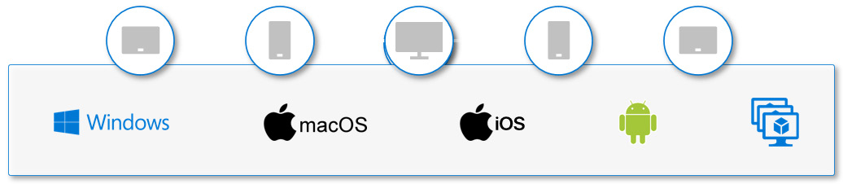
What does WUfB allow me to configure?
Feature updates
Upgrades
Quality updates
OS Updates
Driver updates
Non-Microsoft
Microsoft product updates
Microsoft Certified Drivers
Bring your own device
Figure 18 Microsoft Endpoint Manager endpoint support
Notes:
When you configure WUfB policy from Microsoft Intune with the configuration setting, WUfB will be enabled. If you have traditionally utilized WSUS for servicing, your clients will connect to both Windows Update in the cloud as well as your WSUS server once you set WUfB settings. If you want to change this behavior, you need to remove your old configuration settings for WSUS on the endpoints.
Through the Windows Update Client settings (through Group Policy, MDM, or the UX), WUfB provides the ability to delay the application of updates. Quality updates and feature updates are treated separately to give you added flexibility.
In addition, you may leverage the "Pause" functionality if you need time to implement remediation to updates after testing them in earlier rings.
Feature updates
Previously referred to as upgrades, feature updates contain not only security and quality revisions but also significant feature additions and changes. Feature updates are released semi-annually in the fall and the spring.
Quality updates
Quality updates are traditional OS updates, typically released on the second Tuesday of each month (though they can be released at any time). These include security, critical, and driver updates. WUfB also treats non-Windows updates (such as updates for Microsoft Office or Visual Studio) as quality updates. These non-Windows updates are known as Microsoft updates, and you can set devices to receive such updates (or not) along with their Windows updates.
Driver updates
Updates for non-Microsoft drivers that are relevant to your devices. Driver updates are on by default, but you can use WUfB policies to turn them off if you prefer.
Microsoft product updates
Updates for other Microsoft products, such as versions of Office that are installed by using Windows Installer (MSI). Versions of Office that are installed by using Click-to-Run can't be updated by using WUfB. Product updates are off by default. You can turn them on by using WUfB policies.
Windows 10 feature updates policies work in conjunction with your Windows 10 update ring policies to prevent a device from receiving a Windows feature version that's later than the value specified in the feature updates policy.
For Windows 10 feature updates policies to be working, Windows 10, version 1709, or later is required. The devices need to be enrolled in Intune MDM and be hybrid AD-joined, Azure AD-joined, or Azure AD-registered. Windows telemetry needs to be turned on, with a minimum setting of Basic. If telemetry is off, Windows can be upgraded to a later version of Windows than defined in the feature updates policy.
When a device receives a Windows 10 feature updates policy, the device updates to the version of Windows specified in the policy. A device that already runs a later version of Windows remains in its current version. By freezing the version, the device's feature set remains stable for the duration of the policy.
A device will not install an update when it has a safeguard hold for that Windows version. When a device evaluates the applicability of an update version, Windows creates the temporary safeguard hold if an unresolved known issue exists. Once the issue is resolved, the hold is removed, and the device can then update.
Unlike using Pause with an update ring, which expires after 35 days, the Windows 10 feature updates policy remains in effect. Devices won't install a new Windows version until you modify or remove the Windows 10 feature updates policy. If you edit the policy to specify a newer version, devices can then install the features from that Windows version.
Today, there are more than 3,000 Group Policy settings for Windows 10. Although Microsoft provides extensive guidance on different security features, exploring each one can take a long time. You would have to determine the impact of each setting on your own and then determine the appropriate value for each setting.
WUfB for Windows 10 has a set of policies that you can configure to provide the most secure Windows environments as it is updated, as long as the devices have internet connectivity and still keep the best end user experience by configuring policy settings across a number of areas:
Configuring deadlines
Restart behavior
Accounting for low-activity devices (active hours)
Delivery optimization
Power policies
There has always been a tension between the need for being current with software update compliance and the desire to keep the workforce productive. While the security department has a requirement to see a fully updated device fleet within 7 days of a software update, the reality is that deployment of the said update has an associated cost for users, and very few companies can afford to push an update on an entire workforce in the middle of a single working day unless it is a zero-day patch in an emergency.
Given the competing goals of a protected and productive workforce, you may find that you may need to make choices that are less than the best possible selection for maximizing update velocity in favor of an experience more aligned with your business's productivity needs.
Bring your own device
BYOD has different options depending on the Windows SKU. All BYOD scenarios can leverage Windows 365 and Azure Virtual Desktop to get access to either a full desktop or a single application as a remote app. Windows devices can also be registered with Azure AD to gain access to corporate resources such as email.
Enroll the device in Intune as a personally owned device (BYOD). If an administrator has configured autoenrollment (available with Azure AD Premium subscriptions), the user only has to enter their credentials once. Otherwise, they'll have to enroll separately through MDM-only enrollment and re-enter their credentials.
Figure 18 Microsoft Endpoint Manager endpoint support
Microsoft Intune management does not provide the same management capabilities on BYOD; not all Windows editions have the same MDM management setting built in Windows 10 Enterprise has full management features, whereas both the Home and Pro editions have fewer management capabilities due to Windows limitations. Microsoft provides the option for the IT admin to leverage enrollment restrictions so that you can block personal enrollment into Microsoft Intune.

Slide 62
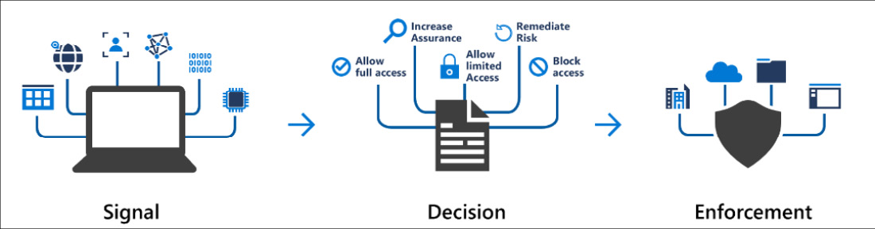
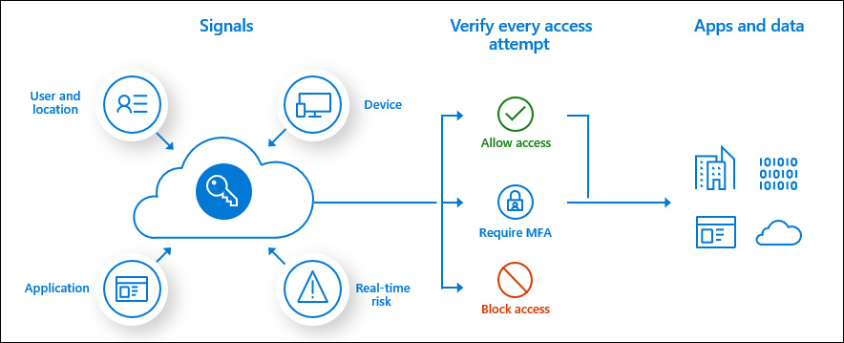
What is zero trust?
Figure 19: Zero trust verifying devices diagram
Verifying identity
Verifying devices
Enforce organizational Conditional Access policies:
Signals
Decision
Enforcement
Notes:
What is zero trust?
In the past, when organizations created remote access to corporate networks, normally, access was effected with a VPN connection either on a corporate-owned or a personally owned Windows device, only secured by an MFA token. Today, organizations require a new security model that effectively adapts to the complexity of the modern environment, embraces the mobile workforce, and protects people, devices, applications, and data wherever they are located.
This is the core of zero trust. Instead of believing that everything behind the corporate firewall is safe, the zero trust model assumes a breach and verifies each request as though it originated from an uncontrolled network. Regardless of where the request originates from or what resource it accesses, the zero trust model teaches us to "never trust, always verify."
Verifying identity
The majority of security breaches today involve credential theft, and lapses in cyber hygiene amplify the potential for risk to employees and to organizations at large. That's why one of the primary components of a zero-trust system is the ability to verify a user's identity before access is granted to the corporate network. Start by implementing MFA through the modern experience of Azure Authenticator and Windows Hello for Business on all Windows 10 devices.
Verifying devices
Because unmanaged devices are an easy entry point for bad actors, ensuring that only healthy and trusted devices can access critical applications and data is vital for enterprise security. A fundamental part of our zero trust implementation is to enroll all end-user devices in device management systems such as Microsoft Intune.
Enabling compliance policies to check the devices for parameters such as BitLocker encryption, secure boot, and device health verification in this way is essential to managing the policies that govern access to corporate resources.
Microsoft Endpoint Manager is a key piece of this new way of thinking as it makes the device trusted, with a compliance policy to validate whether the devices are compliant. Conditional Access is the tool built into Azure AD to bring signals together, make decisions, and enforce organizational Conditional Access policies:
Signals: A device or a user sign-in with a specific application or browser.
Decision: What level of access you will be granted based on the policies.
Enforcement: This could be as simple as giving the end-user access with an MFA token or denying access:
Figure 19: Zero trust verifying devices diagram
Conditional Access policies at their simplest are if-then statements. If a user wants to access a corporate resource, then they must complete an action. For example, if an end user wants to access the corporate Microsoft Teams application then they must come from a compliant device to get access.
IT admins and security admins have two primary goals:
Empower users to be productive wherever and whenever.
Protect the organization's data:
Figure 2.7 – Zero trust verification process flow
By using Conditional Access policies, you can apply the right access controls when needed to keep your organization secure and stay out of your users' way when not needed.
We will be going into more detail on Conditional Access and other security-related improvements in Chapter 10, “ Identity and Security Management.”

Slide 63

lesson Summary
In the next chapter, we're going to talk about Windows 365 and explain this service more.
After this section, we'll continue to take a deeper dive, as we are going to talk about the different endpoint scenarios and requirements in terms of what is needed to use Microsoft Endpoint Manager.
Notes:
In the chapter, we've learned about the fundamentals of unified endpoint management, modern management, and how this relates to Microsoft Endpoint Manager. We also went through the different concepts, services, and products around Windows 10 Enterprise and security-related aspects of zero trust.
In the next chapter, we're going to talk about Windows 365 and explain this service more.
After this section, we'll continue to take a deeper dive, as we are going to talk about the different endpoint scenarios and requirements in terms of what is needed to use Microsoft Endpoint Manager.

Slide 64

Cloud management Gateway (CMG)
Notes:
The cloud management gateway (CMG) provides a simple way to manage Configuration Manager clients over the internet. You deploy the CMG as a cloud service in Microsoft Azure. Then, without additional on-premises infrastructure, you can manage clients that roam on the internet or are in branch offices across the WAN. You also don't need to expose your on-premises infrastructure to the internet.

Slide 65

Cloud management
After establishing the prerequisites, creating the CMG consists of the following three steps in the Configuration Manager console:
Deploy the CMG cloud service to Azure.
Add the CMG connection point role.
Configure the site and site roles for the service.
Notes:
Once deployed and configured, clients seamlessly access on-premises site roles whether they're on the intranet or internet.
This article provides the foundational knowledge to learn about the CMG and the scenarios where you can use it.
Scenarios

Slide 66
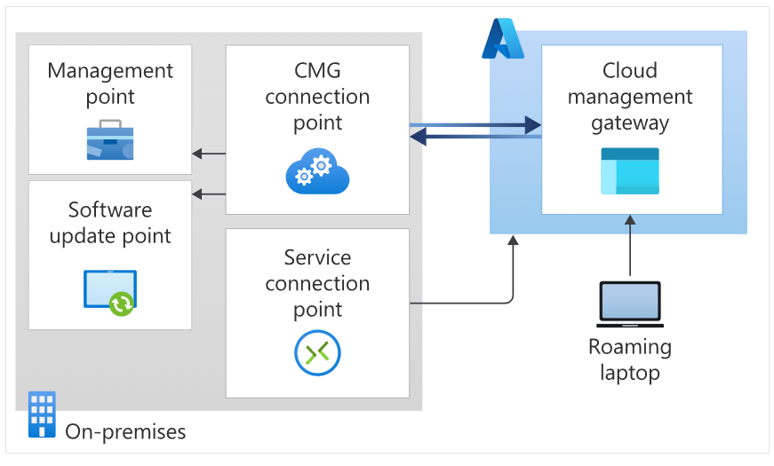

Slide 67
Most Common
Manage traditional Windows clients with Active Directory domain-joined identity. These clients include any supported version of Windows. It uses PKI certificates to secure the communication channel. Management activities include:
Software updates and endpoint protection
Inventory and client status
Compliance settings
Software distribution to the device
Windows in-place upgrade task sequence

Slide 68

Specific use cases
Across these scenarios, the following specific device use cases may apply:
Roaming devices such as laptops
Remote/branch office devices that are less expensive and more efficient to manage over the internet than across a WAN or through a VPN.
Mergers and acquisitions, where it may be easiest to join devices to Azure AD and manage through a CMG.
Workgroup clients. These devices may require other configurations, such as certificates.
To help with management of remote workgroup clients, use Configuration Manager token-based authentication. For more information, see Token-based authentication for CMG.

Slide 69
Most Common
Manage traditional Windows 10 or later clients with modern identity, either hybrid or pure cloud domain-joined with Azure Active Directory (Azure AD). Clients use Azure AD to authenticate rather than PKI certificates. Using Azure AD is simpler to set up, configure and maintain than more complex PKI systems. Management activities are the same as the first scenario plus:
Software distribution to the user

Slide 71
Chapter Overview
we'll go through the following topics:
Endpoint scenarios
Identity roles and privileges
Network URL firewall requirements
Licensing requirements
Supported OSes
Windows 11 hardware requirements

Slide 72
Microsoft Endpoint Manager Scenarios.
Page 83
The endpoint scenarios that are supported are as follows:
Physical desktops
Cloud PC endpoints
Mobile devices

Slide 73
What is Physical modern desktop?
Modern desktop is:
State-of-the-art productivity platform for the Information Worker
Microsoft 365 Apps and
Windows 10 and 11are the core components of the modern desktop
Notes:
Physical modern desktop
The modern desktop is the state-of-the-art productivity platform for the Information Worker. Microsoft 365 Apps and Windows 10 are the core components of the modern desktop along with the latest security baselines for Windows 10 and Microsoft Defender for Endpoint.

Slide 74
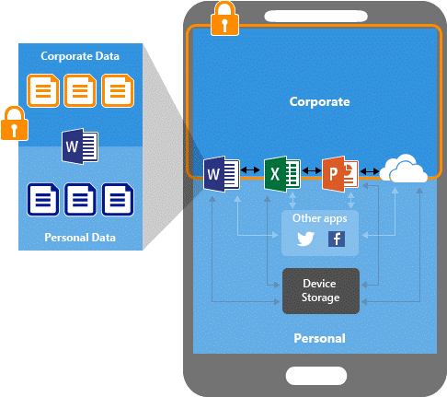
Mobile devices
Secure Microsoft Office mobile apps
Actions:
Encrypt work files.
Require a PIN to access work files.
Require the PIN to be reset after five failed attempts.
Block work files from being backed up in iTunes, iCloud, or Android backup services.
Require work files to only be saved to OneDrive or SharePoint.
Prevent protected apps from loading work files on jailbroken or rooted devices.
Block access to work files if the device is offline for 720 minutes.
Remove work files if device is offline for 90 days.

Slide 75

Cloud PC endpoints
Compliance Administrator
Compliance Data Administrator
Intune Administrator
Message Center Reader
Security Administrator
Security Operator
Security Reader
Notes:
Cloud PC endpoints
Develop, deploy, and manage APIs on any Google Cloud back end. Identity roles and privileges for Microsoft Intune
To configure MEM, you first have to ensure that you have the required privileges. The first user created in your Azure Active Directory (AD) tenant will automatically become the global admin, as a member of the Global Admin role. The Global Admin role has full Microsoft Intune rights.
There are also other roles that could help you in delegating access as part of your user-role design. Some of the next steps for Intune require the Global Admin role, so we recommend using this type of account for the initial setup. Below you will find a list of the supported roles within MEM.
Compliance Administrator
Users with this role have permission to manage compliance-related features in the Microsoft 365 compliance center, Azure, the Microsoft 365 admin center, and Microsoft Compliance Center. Users with this role can view all Intune audit data.
Compliance Data Administrator
Users with this role have permission to track data in the Microsoft 365 compliance center, the Microsoft 365 admin center, and Azure. Users with this role can view all Intune audit data.
Intune Administrator
Users with this role have global permissions within Microsoft Intune. The Intune Administrator role contains the ability to manage users and devices in order to associate policies, as well as creating and managing all security groups in Azure AD.
Intune Administrator does not have
admin rights over Office groups.
Message Center Reader
Users in this role can monitor notifications and advisory health updates in the message center for their organization on Microsoft Intune.
This is important for scoped
Intune administrator users.
Security Administrator
Users with this role have permission to manage security-related features in the Microsoft 365 security center, Azure AD authentication, Azure AD Identity Protection, Azure Information Protection, and Microsoft 365 Compliance Center. Users in this role can view user, device, enrollment, configuration, and application information. However, they cannot make changes to Intune.
Security Operator
Users with this role can manage alerts and have global read-only access to security-related features, including all information in the Microsoft 365 security center, Identity Protection, Azure AD, Privileged Identity Management, and Microsoft 365 Compliance Center. Users in this role can view user, device, enrollment, configuration, and application information. However, they cannot make changes to Intune.
Security Reader
Users with this role have global read-only access to security-related features, including all information in the Microsoft 365 security center, Azure AD, Privileged Identity Management, Identity Protection, and Microsoft 365 Compliance Center, as well as the ability to read Azure AD sign-in reports and audit logs. Users in this role can view user, device, enrollment, configuration, and application information. However, they cannot make changes to Intune.

Slide 76

Identity roles and privileges for a Windows 365 cloud PC
Azure Subscription Owner
Has global access to all resources in the Azure subscription
Intune Administrator
Has global permissions within Microsoft Intune
Domain Administrator
Able to create computer accounts in your on-premises domain
Notes:
dentity roles and privileges for a Windows 365 cloud PC
In order to use a Windows 365 cloud PC, your Azure AD configuration should be hybrid Azure AD-joined (HAADJ) to enroll your cloud PCs into Intune.
Azure Subscription Owner
Users with this role have global access to all resources in the Azure subscription. These rights are needed for the initial setup of Windows 365.
This role grants users full access to manage all resources, including the ability to assign roles in Azure RBAC.
Intune Administrator
Users with this role have global permissions within Microsoft Intune.
The Intune Administrator role contains the ability to manage users and devices in order to associate policies, as well as creating and managing all security groups in Azure AD.
Intune Administrator does not have admin
rights over Office groups.
Domain Administrator
Users with this role will be able to create computer accounts in your on-premises domain. This is needed to create the computer accounts for cloud PCs in your domain. You can also delegate access via delegation of control directly with the right Organizational Unit on your domain.

Slide 77

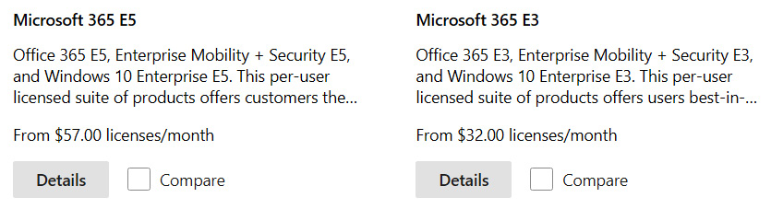
Identity roles and privileges for Universal Print
Printer Administrator
Printer Technician
Here are the types of licenses that provide access to MEM:
Intune-only license
Microsoft 365 E3
Microsoft E5
Enterprise Mobility + Security (EMS) E5
Notes:
Identity roles and privileges for Universal Print
Universal Print introduced two roles, Printer Administrator and Technician, to Azure AD. The Printer Administrator is needed to do the initial configuration. A Global Admin account will be sufficient too. We will talk more about Universal Print later on in the book.
Printer Administrator
Users in this role have full access to manage all aspects of printers in Universal Print.
Printer Technician
Users in this role can register and un-register printers and set the printer status. Licensing requirements
To use MEM, you have to be entitled to an Intune license. There are also options to obtain a trial license for 30 days to kick the tires and validate the service.
MEM as a service doesn't require an Azure subscription; however, when you use the service together with a cloud PC, you'll need to set up an Azure virtual network and, therefore, you need an Azure subscription. An Azure subscription will not be necessary when Azure AD join is supported with cloud PCs (coming soon).
Here are the types of licenses that provide access to MEM:
Intune-only license
Microsoft 365 E3
Microsoft E5
Enterprise Mobility + Security (EMS) E5
It's likely that your company already owns one of these licenses and therefore already has access to MEM.
Creating a trial account is relatively easy; you just go to admin.microsoft.com and click on Billing, followed by Purchase services. Search for one of the licenses listed previously and purchase the trial (for free). There's no credit card or anything needed for this process:

Slide 78
Supported OS
Microsoft:
Windows 11 (Enterprise single- and multi-session versions)
Windows 10 (Enterprise single- and multi-session versions)
Windows 10 Pro, Education
Windows 10 Enterprise 2019 LTSC
Windows 10 IoT Enterprise (x86, x64)
Windows 10 Teams – Surface Hub
Windows Holographic for Business
Supported mobile OS:
Apple:
Apple iOS 12.0 and later
Apple iPadOS 13.0 and later
Mac OS X 10.13 and later
Google:
Android 6.0 and later (including Samsung Knox Standard 2.4 and higher)
Required web browser versions
Different administrative tasks require that you use one of the following administrative websites:
MEM admin portal
Microsoft 365 admin portal
Azure portal
The following browsers are supported for these portals:
Microsoft Edge – Chromium-based (latest version)
Safari (latest version, Mac only)
Chrome (latest version)
Firefox (latest version)
Notes:
Microsoft:
Windows 11 (Enterprise single- and multi-session versions)
Windows 10 (Enterprise single- and multi-session versions)
Windows 10 Pro, Education
Windows 10 Enterprise 2019 LTSC
Windows 10 IoT Enterprise (x86, x64)
Windows 10 Teams – Surface Hub
Windows Holographic for Business
Supported mobile OSes:
Apple:
Apple iOS 12.0 and later
Apple iPadOS 13.0 and later
Mac OS X 10.13 and later
Google:
Android 6.0 and later (including Samsung Knox Standard 2.4 and higher)
Next, we will see what versions of web browsers support MEM.
Required web browser versions
Different administrative tasks require that you use one of the following administrative websites:
MEM admin portal
Microsoft 365 admin portal
Azure portal
The following browsers are supported for these portals:
Microsoft Edge – Chromium-based (latest version)
Safari (latest version, Mac only)
Chrome (latest version)
Firefox (latest version)
Now that we know about the OS and browser requirements, let's take a look at the hardware requirements for Windows 11.

Slide 79
Windows 11 requirements
Windows 11 compared to Windows 10:
Processor: 1 gigahertz (GHz) or faster with two or more cores on a compatible 64-bit processor (https://aka.ms/CPUlist) or system on a chip (SoC).
RAM: 4 gigabytes (GB) or greater.
Storage: 64 GB* or greater available storage is required to install Windows 11 (additional storage space might be required to download updates and enable specific features).
Graphics card: Compatible with DirectX 12 or later, with a WDDM 2.0 driver.
System firmware: UEFI, Secure Boot-capable.
TPM: Trusted Platform Module (https://docs.microsoft.com/en-us/windows/security/information-protection/tpm/trusted-platform-module-overview).
Display: High-definition (720p) display, 9" or greater monitor, 8 bits per color channel.
Internet connection: Internet connectivity is necessary to perform updates.

Slide 80
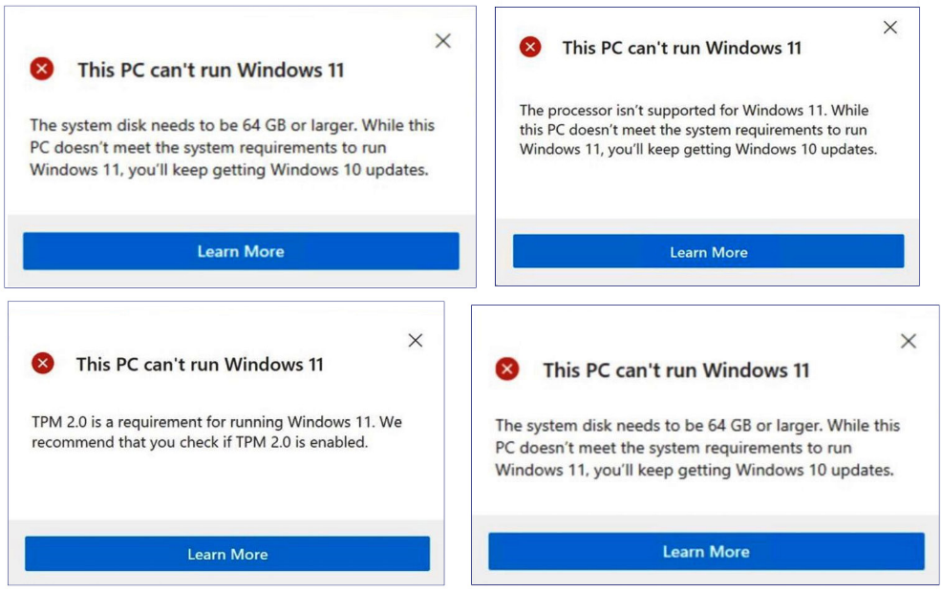
Significant differences between Windows 10 and 11
Understand before upgrading. You can find them in the following list:
Start is significantly changed in Windows 11, including the following key deprecations and removals:
Live tiles
Dynamic previews
Named groups and folders of apps
Pinned apps and sites will not migrate when upgrading from Windows 10.
New modern icons for Windows.
Teams is integrated into the OS.
The Windows Store app has been updated and allows the installation of Win32 applications.
A new feature with the flexibility of multiple windows and the ability to snap apps side by side.
Live tiles are no longer available. For glanceable, dynamic content, please check out the new widgets feature.
Tablet mode is removed and new functionality and capability are included for keyboard attach and detach postures.
Taskbar functionality has changed, including the following:
People is no longer present on the taskbar.
Some icons may no longer appear in the system tray (systray), including previous customizations for upgraded devices.
Only alignment to the bottom of the screen is allowed.
Apps can no longer customize areas of the taskbar.
Timeline is removed. Some similar functionality is available in Microsoft Edge.
Internet Explorer is removed. Edge is the recommended replacement and includes IE mode, which may be useful in certain scenarios.
Math Input Panel is removed.
Snipping Tool continues to be available but the old design and functionality in the Windows 10 version have been replaced with those of the app previously known as Snip & Sketch.
Center alignment on the desktop.
Figure 21 Compatibility errors
Notes:
Windows 11 requirements
Windows 11 is a brand-new Microsoft OS that was announced on 24th June 2021. Windows 11 will be generally available 5th October 2021. The good news is that Windows 11 is completely manageable from MEM, to a similar degree to the CSP/settings that you are familiar with for Windows 10. However, there are some fundamental changes to the requirements of the hardware for Windows 11 compared to Windows 10 that I'd like to explain:
Processor: 1 gigahertz (GHz) or faster with two or more cores on a compatible 64-bit processor (https://aka.ms/CPUlist) or system on a chip (SoC).
RAM: 4 gigabytes (GB) or greater.
Storage: 64 GB* or greater available storage is required to install Windows 11 (additional storage space might be required to download updates and enable specific features).
Graphics card: Compatible with DirectX 12 or later, with a WDDM 2.0 driver.
System firmware: UEFI, Secure Boot-capable.
TPM: Trusted Platform Module (https://docs.microsoft.com/en-us/windows/security/information-protection/tpm/trusted-platform-module-overview).
Display: High-definition (720p) display, 9" or greater monitor, 8 bits per color channel.
Internet connection: Internet connectivity is necessary to perform updates.
Note: There might be additional requirements over time for updates and enable specific features within the operating system.
The requirements are important to follow as you might run into complications once Windows 11 is generally available:

Slide 81
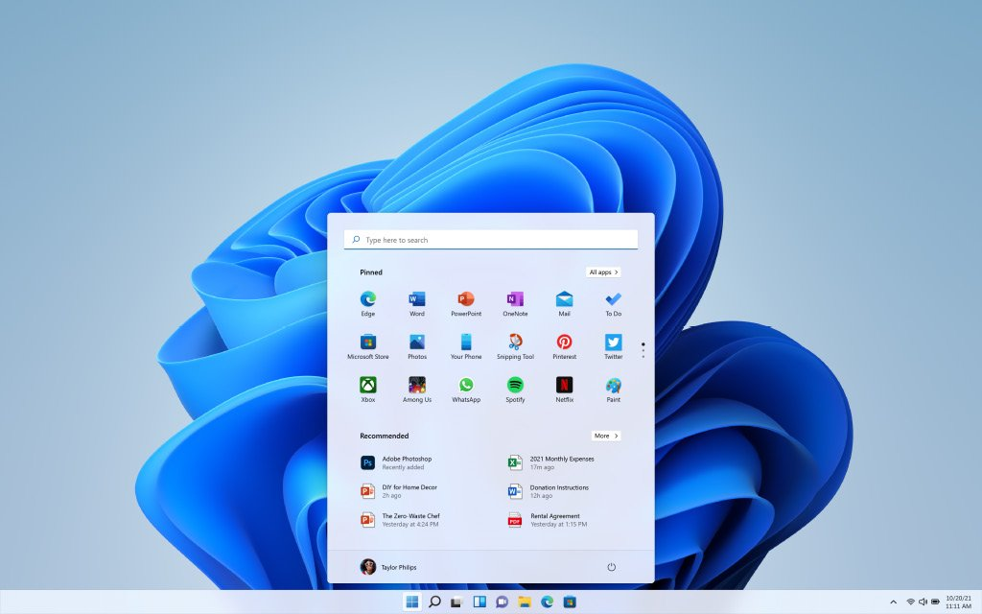
Windows 11 Desktop
Figure 22: Windows 11 UI

Slide 82
Customizing the Logon-Screen, Company Portal and Website

Slide 83
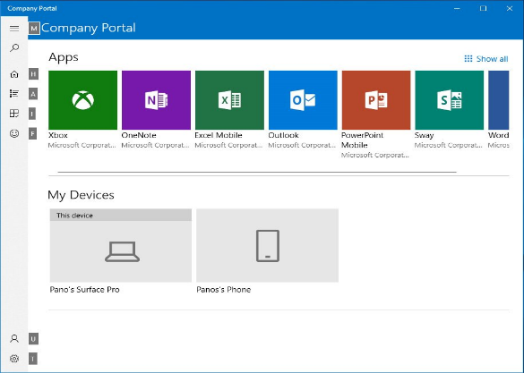
Customizations
Company portal:
Azure AD Enterprise applications
Office Online applications
You can use the hide features to prevent or allow users from performing self-service actions on devices in the company portal website and client apps.
Actions are available:
Hide the remove button on corporate Windows devices.
Hide the reset button on corporate Windows devices.
Hide the remove button on corporate iOS/iPadOS devices.
Hide the reset button on corporate iOS/iPadOS devices.
Table 4 Company portal – example

Slide 84
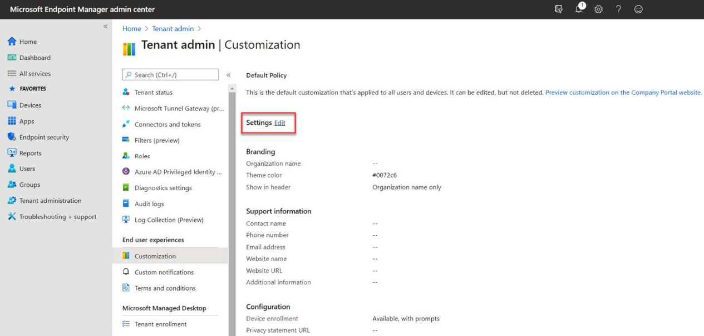
Customizing company portal apps

Slide 85
Associating your Microsoft Store for Business account with Intune
Association examples:
You can synchronize the list of apps you have purchased (or that are free) from the store with Intune.
Apps that are synchronized appear in the MEM admin center; you can assign these apps like any other apps.
Both online and offline licensed versions of apps are synchronized to Intune. App names will be appended with Online or Offline in the portal.
You can track how many licenses are available and how many are being used in the Intune administration console.
Intune blocks the assignment and installation of apps if there is an insufficient number of licenses available.
Apps managed by Microsoft Store for Business will automatically revoke licenses when a user leaves the enterprise, or when the administrator removes the user and the user devices.
Notes:
Associating your Microsoft Store for Business account with Intune
Microsoft Store for Business gives you a place to find and purchase apps for your organization, individually or in volume. You can manage volume-purchased apps from the Azure portal by connecting the store to Microsoft Intune. See the following examples:
You can synchronize the list of apps you have purchased (or that are free) from the store with Intune.
Apps that are synchronized appear in the MEM admin center; you can assign these apps like any other apps.
Both online and offline licensed versions of apps are synchronized to Intune. App names will be appended with Online or Offline in the portal.
You can track how many licenses are available and how many are being used in the Intune administration console.
Intune blocks the assignment and installation of apps if there is an insufficient number of licenses available.
Apps managed by Microsoft Store for Business will automatically revoke licenses when a user leaves the enterprise, or when the administrator removes the user and the user devices.
Important: Microsoft Store for Business and Microsoft Store for Education will be retired in the first quarter of 2023. Customers may continue to use the current capabilities for free apps until that time. There will be no support for Microsoft Store for Business and Education on Windows 11. You can still leverage Microsoft Intune to deploy apps from Microsoft Store for Business on Windows 11 both as required and as available in the company portal.
As Microsoft Store for Business is still important to get Store apps to a Windows device, we will still advise you to create the connection with the following guidelines:

Slide 87

Labs

